Slide 1
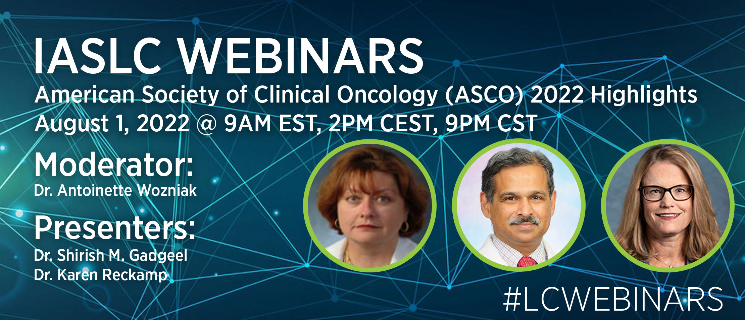

Slide 2


Lung Cancer- ASCO 2022
IASLC Webinar
Shirish M. Gadgeel, MD
Henry Ford Cancer Institute/Henry Ford Health
Shirish M. Gadgeel, Henry Ford Cancer Institute/Henry Ford Health

Slide 3
Conflicts of Interest
Advisory Boards- Astra-Zeneca, Takeda, Bristol Myers-Squibb, Pfizer, Genentech/Roche, Mirati, Daichii, Novartis, Blueprint, Janssen, Merck, GSK
DSMB- Astra-Zeneca

Slide 4
Agenda
Abstract 9001- FDA analysis of ICI with or without chemotherapy in Kras mutation positive NSCLC
Abstract 9002- Krsytal-1, Adgrasib in Kras mutation positive NSCLC
LBA abstract 9009- Adgrasib in Kras mutation positive NSCLC with unreated brain mets
Abstract 9006- Amivantamab and Lazertinib in recurrent EGFR mutation positive NSCLC. Chrysalis- 2
Abstract 9008- Amivantamab in exon 14 skipping mutation positive NSCLC.
Abstract 9007- CLN-081 in EGFR exon 20 mutation positive NSCLC.

Slide 5
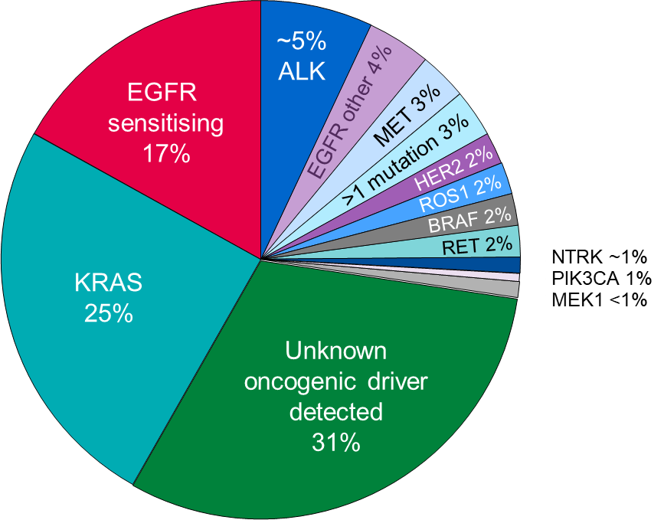
Genomic Alterations in Adenocarcinoma
KRAS mutations- 30%
KRAS G12C- 40% KRAS
Co-mutations in p53, STK11, KEAP1
1. Tsao JTO 2016; 2. Skoulidis Nature Review, Cancer 2019

Slide 6
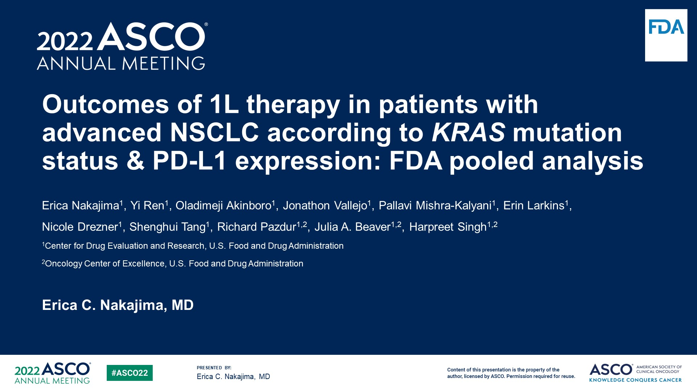
Outcomes of 1L therapy in patients with advanced NSCLC according to KRAS mutation status & PD-L1 expression: FDA pooled analysis
Content of this presentation is the property of the author, licensed by ASCO. Permission required for reuse.

Slide 7
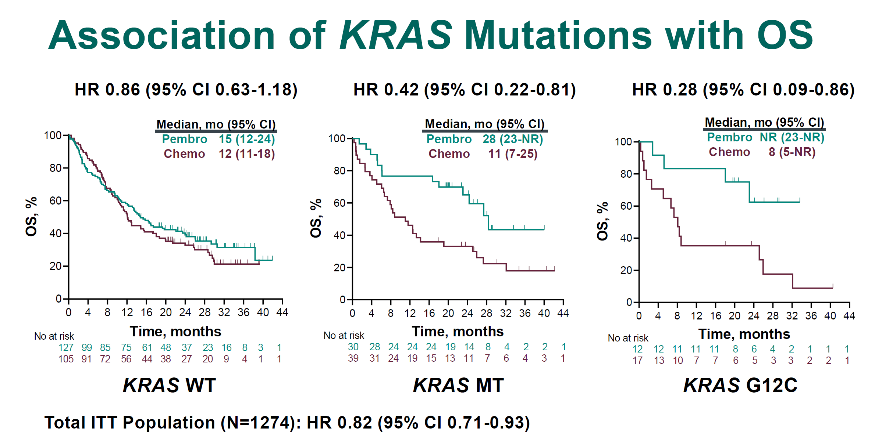
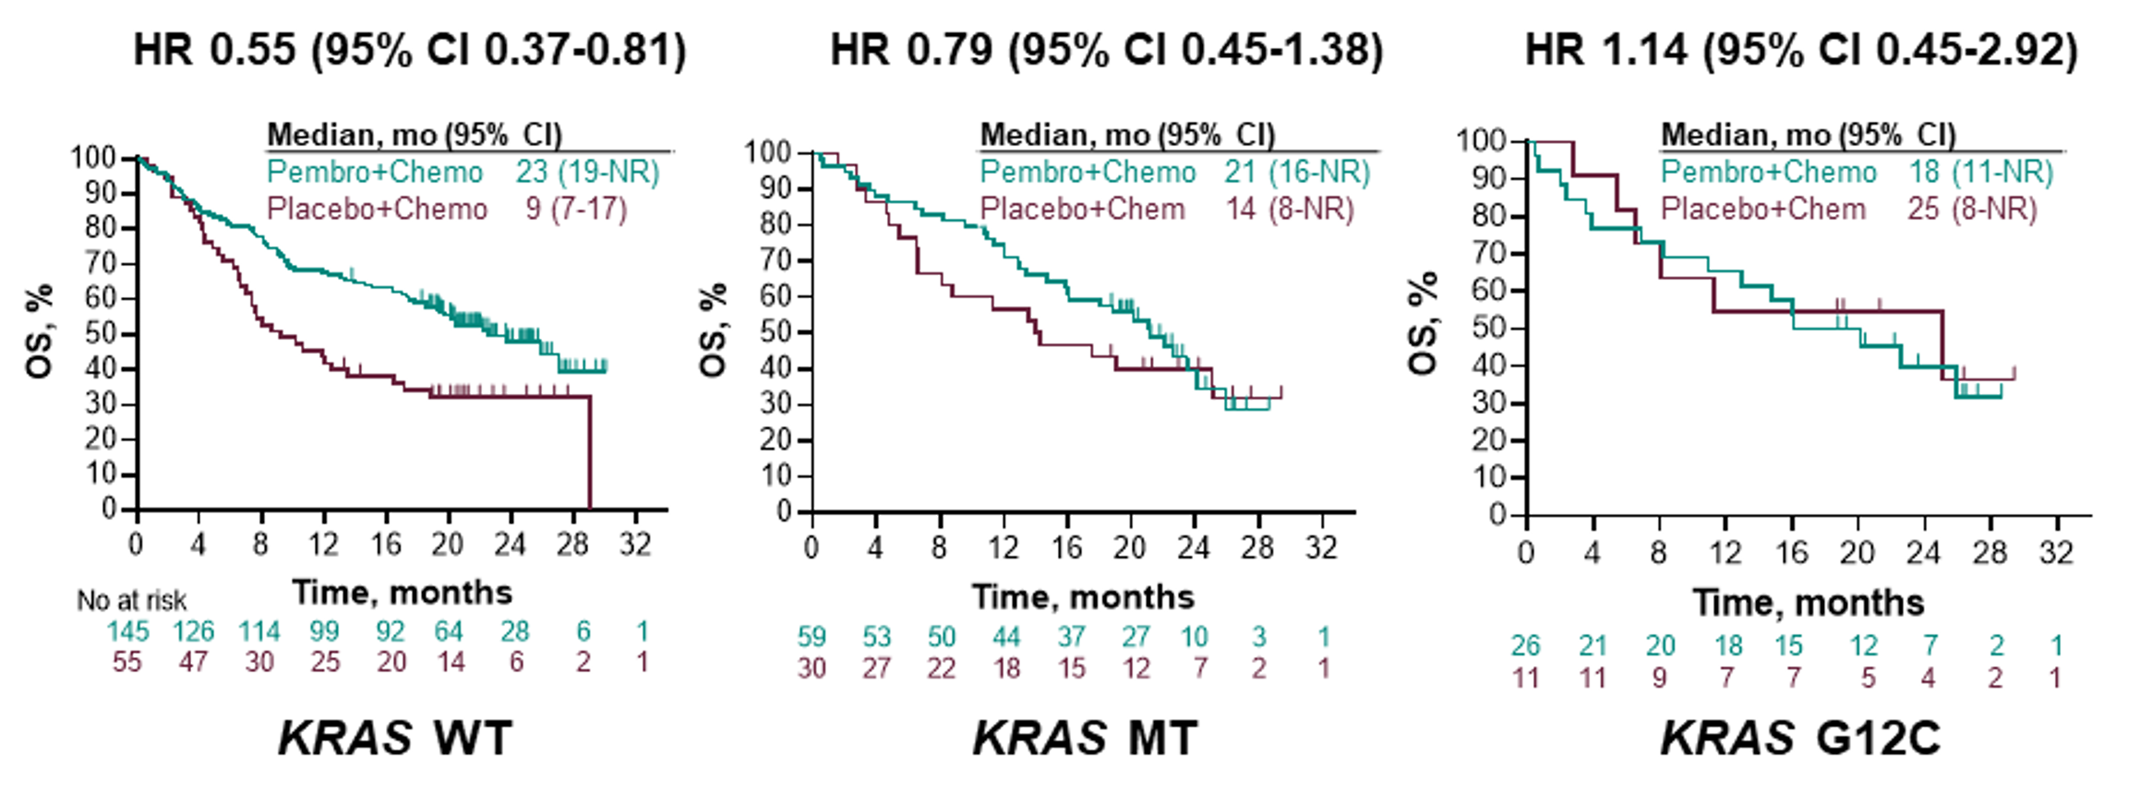
Kras mutation- Pembrolizumab with and without chemotherpay
Herbst, KN 42; ESMO 2019
Gadgeel, KN 189; ESMO-IO 2019

Slide 8
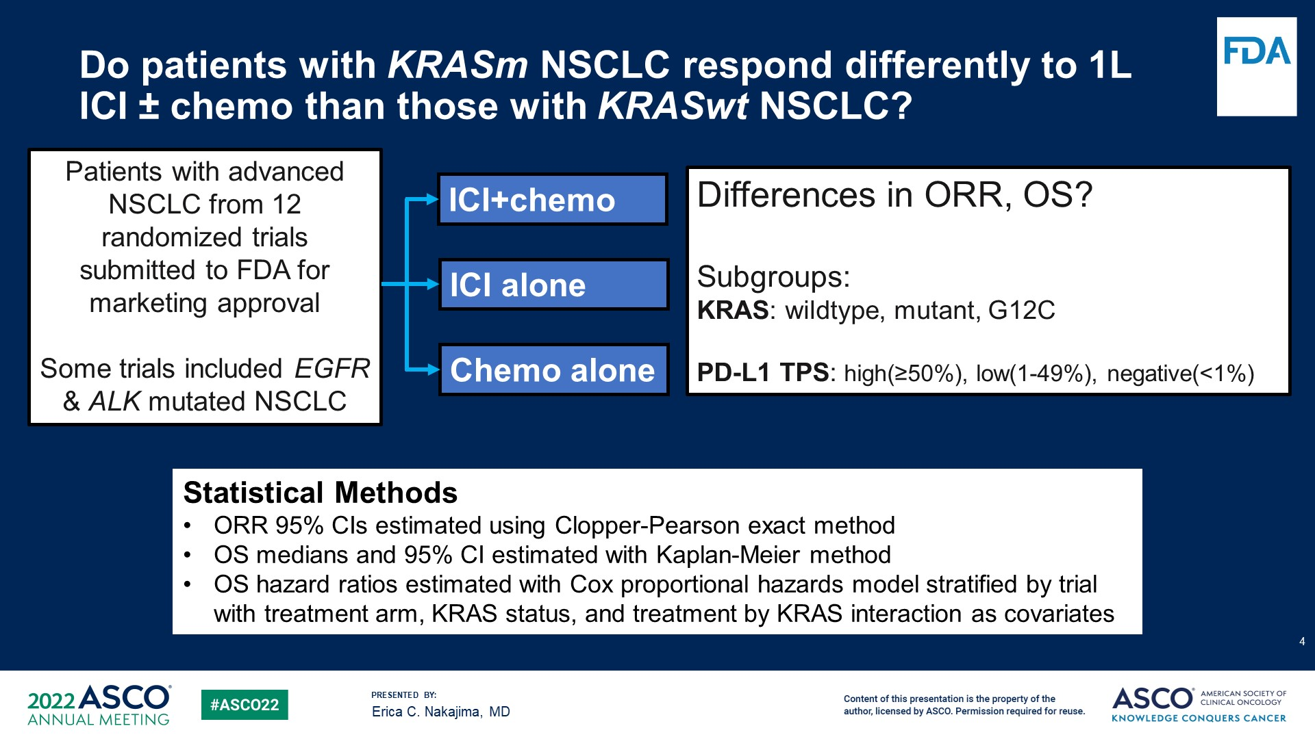
Do patients with KRASm NSCLC respond differently to 1L ICI ± chemo than those with KRASwt NSCLC?
Content of this presentation is the property of the author, licensed by ASCO. Permission required for reuse.

Slide 9
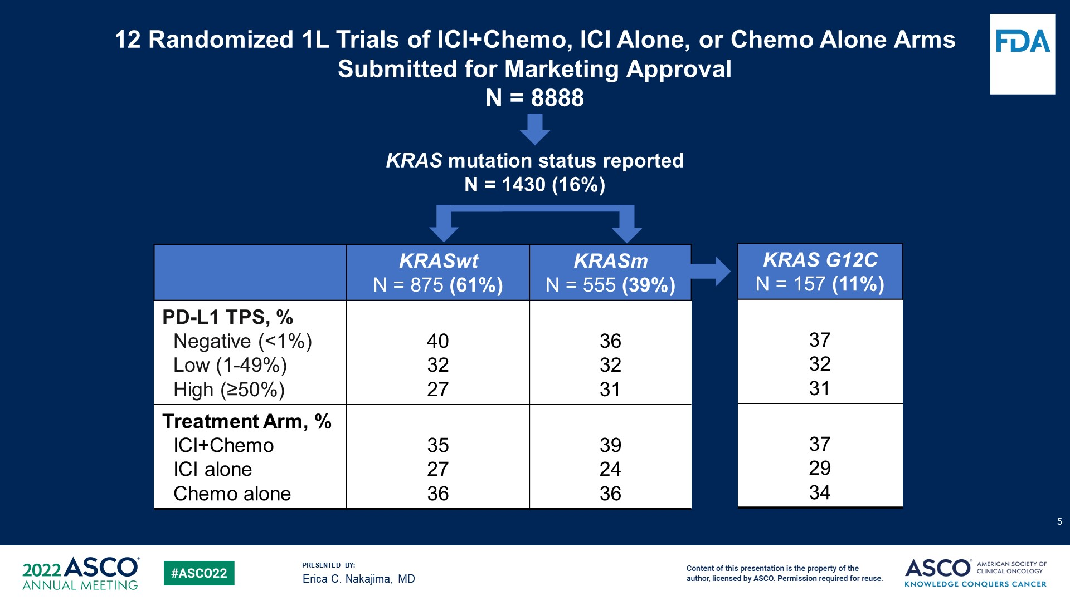
Slide 5
Content of this presentation is the property of the author, licensed by ASCO. Permission required for reuse.

Slide 10
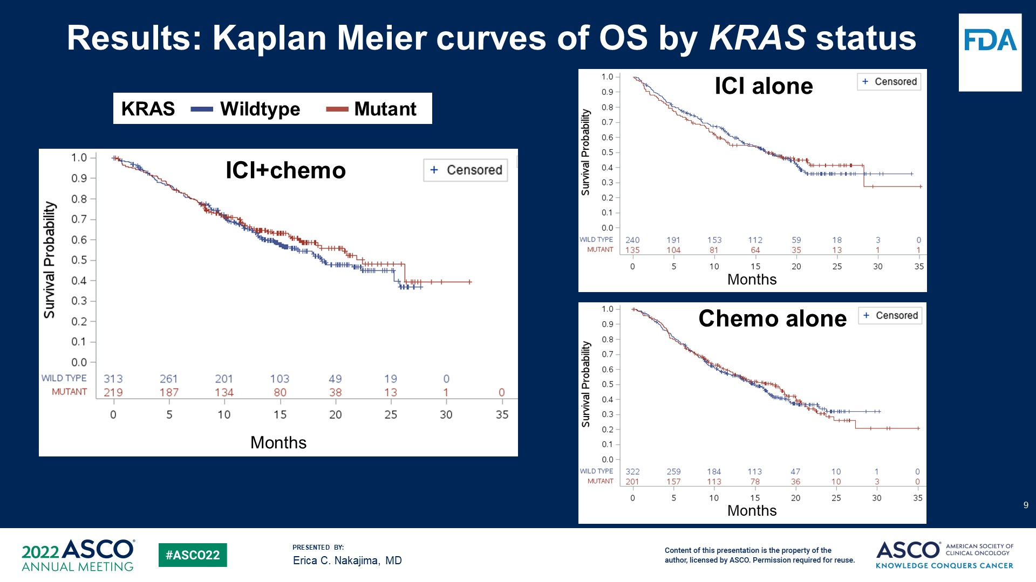
Results: Kaplan Meier curves of OS by KRAS status
HR ranged from 1.01- 1.12
Content of this presentation is the property of the author, licensed by ASCO. Permission required for reuse.

Slide 11
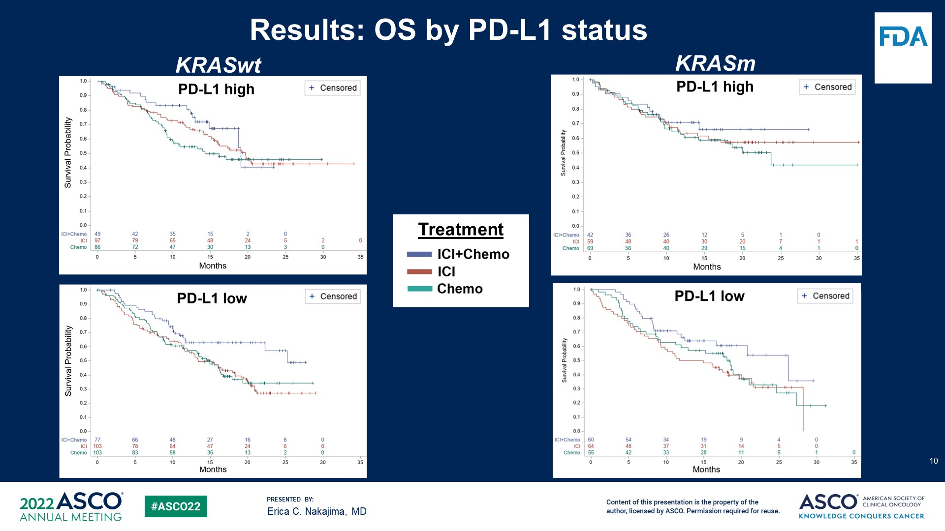
Results: OS by PD-L1 status
Content of this presentation is the property of the author, licensed by ASCO. Permission required for reuse.

Slide 12
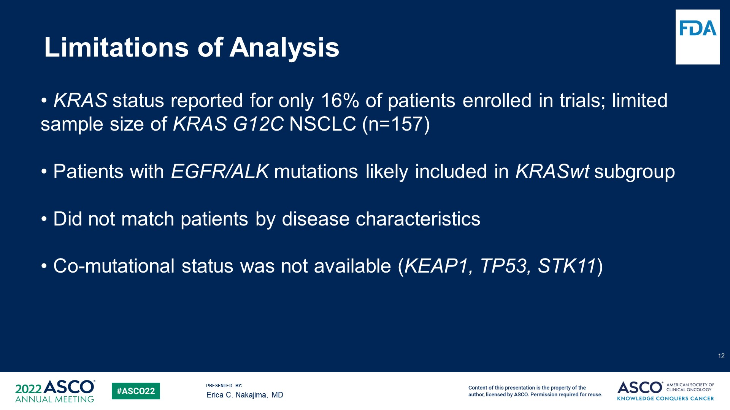
Limitations of Analysis
Content of this presentation is the property of the author, licensed by ASCO. Permission required for reuse.

Slide 13
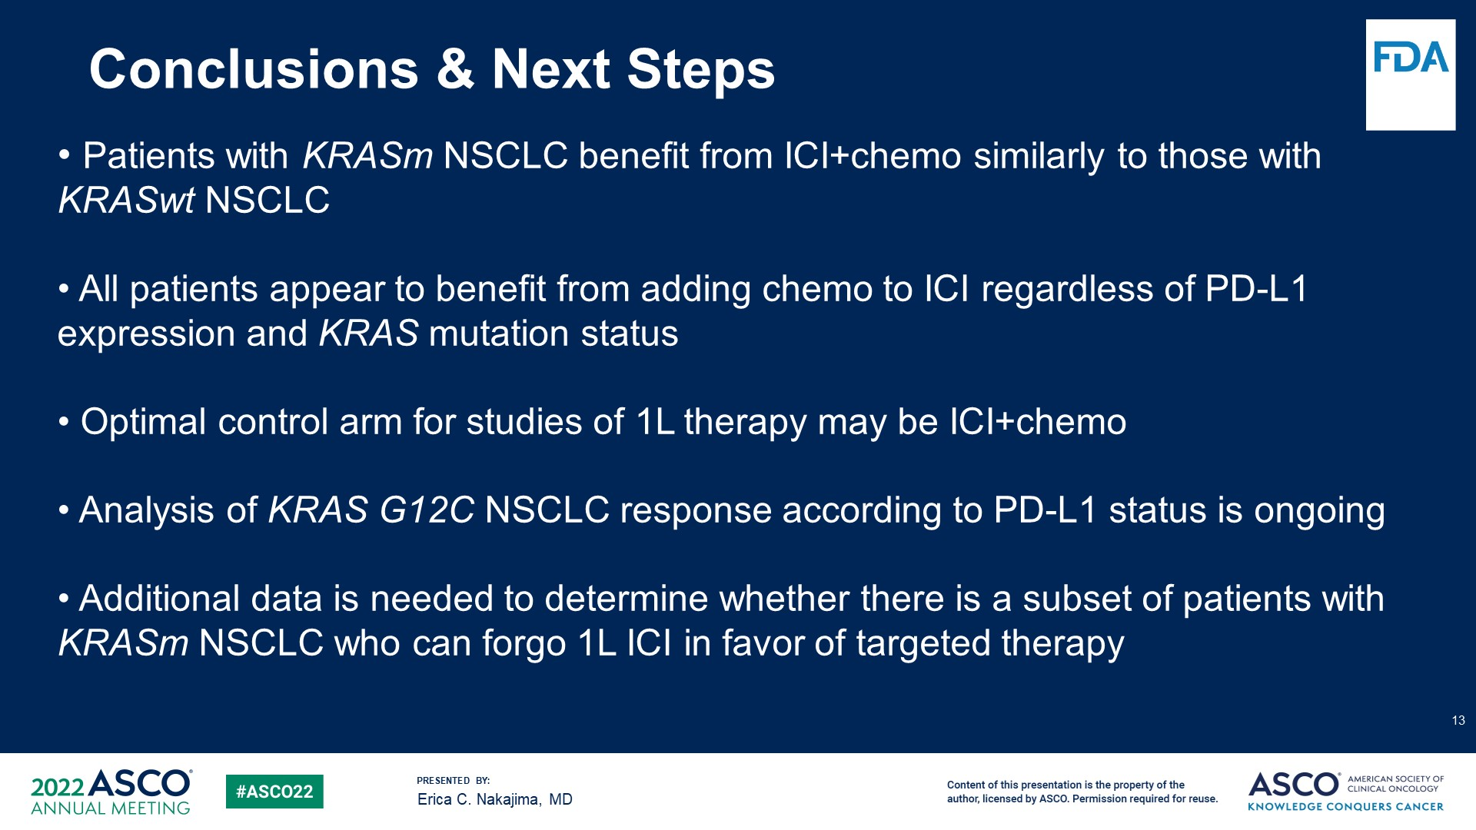
Conclusions & Next Steps
Content of this presentation is the property of the author, licensed by ASCO. Permission required for reuse.

Slide 14

KRYSTAL-1: Activity and Safety of Adagrasib (MRTX849) in Patients with Advanced/Metastatic Non-Small Cell Lung Cancer Harboring a KRAS^{G12C} Mutation
Alexander I. Spira¹, Gregory J. Riely², Shirish M. Gadgeel³, Rebecca S. Heist⁴, Sai-Hong Ignatius Ou⁵, Jose M. Pacheco⁶, Melissa L. Johnson⁷, Joshua K. Sabari⁸, Konstantinos Leventakos⁹, Edwin Yau¹⁰, Lyudmila Bazhenova¹¹, Marcelo V. Negrao¹², Nathan A. Pennell¹³, Jun Zhang¹⁴, Karen Velastegui¹⁵, James G. Christensen¹⁵, Xiaohong Yan¹⁵, Kenna Anderes¹⁵, Richard C. Chao¹⁵, Pasi A. Jänne¹⁶
¹Virginia Cancer Specialists, Fairfax, VA; US Oncology Research, The Woodlands, TX; NEXT Oncology Virginia, Fairfax, VA; ²Memorial Sloan Kettering Cancer Center, Weill Cornell Medical College, New York, NY; ³Henry Ford Cancer Institute, Detroit, MI; ⁴Massachusetts General Hospital, Boston, MA; ⁵University of California, Irvine, Chao Family Comprehensive Cancer Center, Orange, CA; ⁶University of Colorado Anschutz Medical Campus, Aurora, CO; ⁷Sarah Cannon Research Institute Tennessee Oncology, Nashville, TN; ⁸Perlmutter Cancer Center, New York University Langone Health, New York, NY; ⁹Mayo Clinic, Rochester, MN; ¹⁰Roswell Park Comprehensive Cancer Center, Buffalo, NY; ¹¹UC San Diego Moores Cancer Center, La Jolla, CA; ¹²MD Anderson Cancer Center, Houston, TX; ¹³Cleveland Clinic, Cleveland, OH; ¹⁴University of Kansas Medical Center, Kansas City, KS; ¹⁵Mirati Therapeutics, Inc., San Diego, CA; ¹⁶Dana-Farber Cancer Institute, Boston, MA
Dr Alexander I. Spira

Slide 15
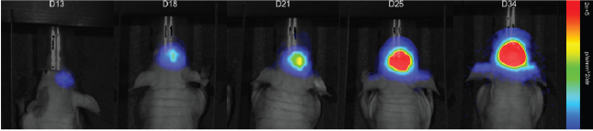
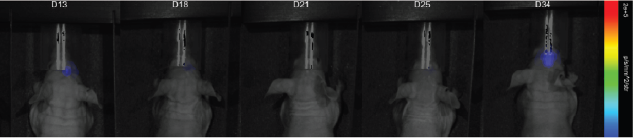
Adagrasib (MRTX849) is a Differentiated KRAS^{G12C} Inhibitor
KRAS^{G12C} mutations act as oncogenic drivers and occur in ~14% of patients with NSCLC (adenocarcinoma)¹
Approximately 27–42% of patients with KRAS^{G12C}-mutated NSCLC have CNS metastases at diagnosis^{2,3}
Adagrasib, a covalent inhibitor of KRAS^{G12C}, was optimized for desired properties of a KRAS^{G12C} inhibitor, including a long half-life (23 hours), dose-dependent PK and CNS penetration^{4,5}
In the FIH Phase 1/1b trial of adagrasib in patients with KRAS^{G12C-}mutated NSCLC (n=15), the ORR was 53.3%, median DOR was 16.4 months, and median PFS was 11.1 months⁶
Adagrasib demonstrated CNS penetration and CNS tumor regressions in preclinical models.⁷ In a preliminary analysis in a Phase 1b cohort evaluating adagrasib in patients with NSCLC and active, untreated CNS metastases (n=2):⁷
Mean K_{p,uu} value was 0.47
Regression of CNS metastases was observed in both patients
LU99Luc KRAS^{G12C} Brain Metastases Model⁷
Vehicle
D13
D18
D21
D25
D34
Adagrasib (100 mg/kg BID)
D13
D18
D21
D25
D34
Clinical activity with adagrasib has been shown in patients with various KRAS^{G12C}-mutated solid tumors, including NSCLC, CRC, PDAC, ovarian and endometrial cancers, and other GI cancers^{5,8–10}

Slide 16
Demographics and Baseline Characteristics
 | Adagrasib Monotherapy (N=116)ª
Median age (range), years | 64 (25–89)
Female sex, n (%) | 65 (56%)
Race, n (%) White Black or African American Asian / Other | 97 (84%) 9 (8%) 5 (4%) / 5 (4%)
ECOG PS, n (%)^{b} 0 / 1 | 18 (16%) / 97 (84%)
Smoking history, n (%) Never smoker Current smoker / former smoker | 5 (4%) 11 (10%) / 100 (86%)
Prior lines of systemic therapy, n (%) 1 2 3+ | 50 (43%) 40 (35%) 26 (22%)
Prior platinum-based therapy and/or checkpoint inhibitor therapy, n (%)^{c} Received prior platinum-based therapy only Received both | 2 (2%) 114 (98%)
Baseline metastases, n (%) Bone CNS Adrenal Liver | 46 (40%) 24 (21%) 22 (19%) 19 (16%)
ªAmong the enrolled patients, 113 (97%) had adenocarcinoma and 3 (3%) had squamous histology; 103 patients (89%) had metastatic disease and 13 (11%) had locally advanced disease; ^{b}Missing, n=1; ^{c}78 patients (67%) had received checkpoint inhibitor therapy as their immediate prior line of therapy

Slide 17
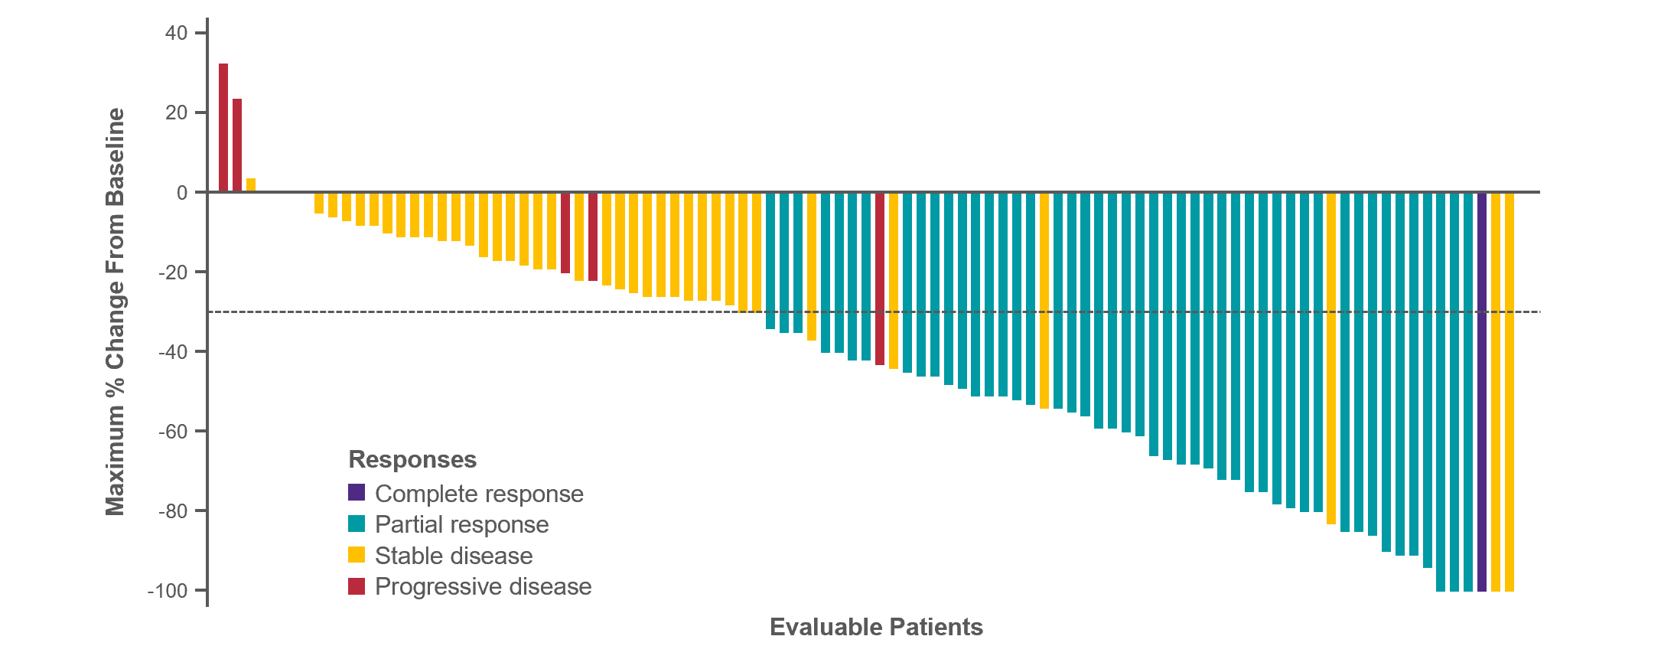
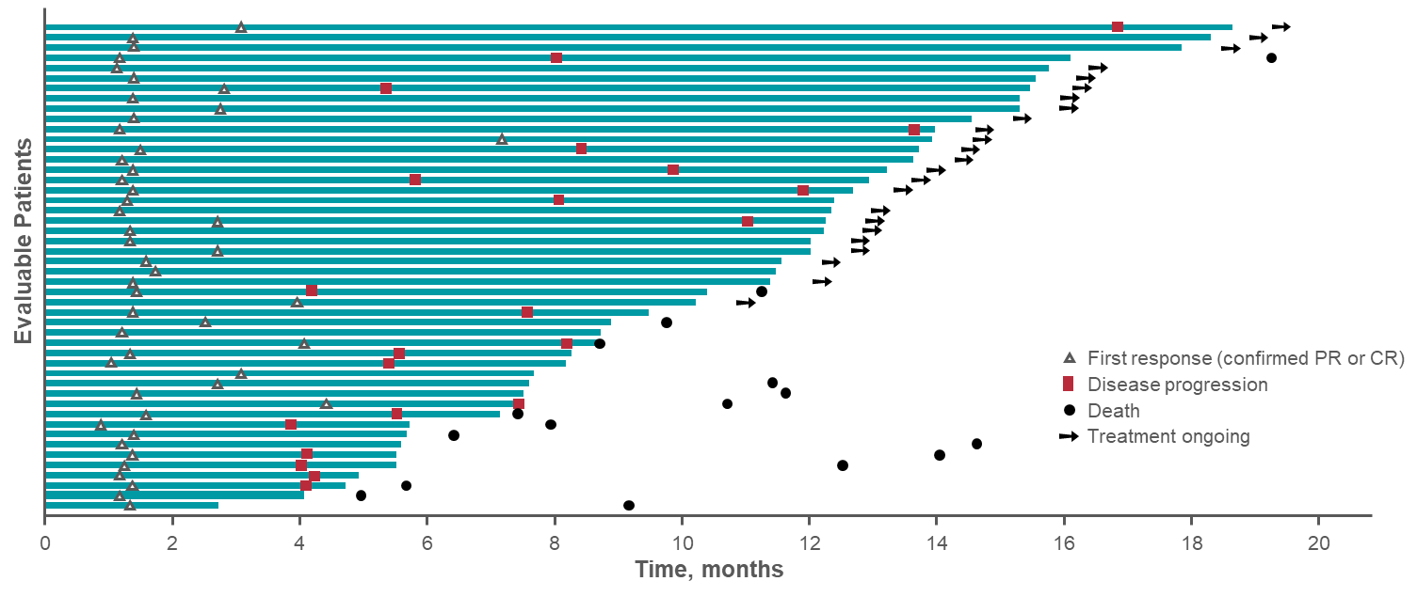
Adagrasib in Previously Treated Patients with KRAS^{G12C}-mutated NSCLC: Best Tumor Change From Baseline
Objective responses were observed in 43% (95% CI, 33.5–52.6); DCR was 80% (95% CI, 70.8–86.5)
Median DOR 8.5 months (95%CI- 6.2-13.8)
Median PFS 6.5 mo (95% CI- 4.7-8.4); Median OS- 12.6 mo (95% CI- 9.2-19.2)
All results are based on BICR. Responses include target lesion tumor regression, as well as non-target lesion assessment
Data as of October 15, 2021 (median follow-up: 12.9 months)

Slide 18
Adagrasib in Previously Treated Patients with KRAS^{G12C}-mutated NSCLC: Pre-specified Correlative Analyses
ORR in Patients Harboring KRAS^{G12C} Co-mutations
ORR by PD-L1 Subgroupsª
90
58.3%
7/12
90
80
55.9%
19/34
80
41.7% 5/12
51.4%
18/35
70
47.9% 23/48
51.7%
31/60
35.7%
5/14
44%
11/25
70
44.4%
12/27
44.9% 22/49
46.8% 22/47
60
40.5% 17/42
41.7% 25/60
14.3%
1/7
60
28.6%
6/21
50
50
Response Rate (%)
Response Rate (%)
40
40
30
30
20
20
10
10
0
0
WT
MT
WT
MT
WT
MT
WT
MT
STK11 MT/ KEAP1 MT
STK11 MT/ KEAP1 WT
STK11 WT/ KEAP1 MT
STK11 WT/ KEAP1 WT
<1%
1–49%
≥50%
STK11
KEAP1
TP53
CDKN2A
PD-L1 Expression
Tri-mutation
All results are based on BICR
ªPD-L1 was centrally tested
Data as of October 15, 2021 (median follow-up: 12.9 months)

Slide 19
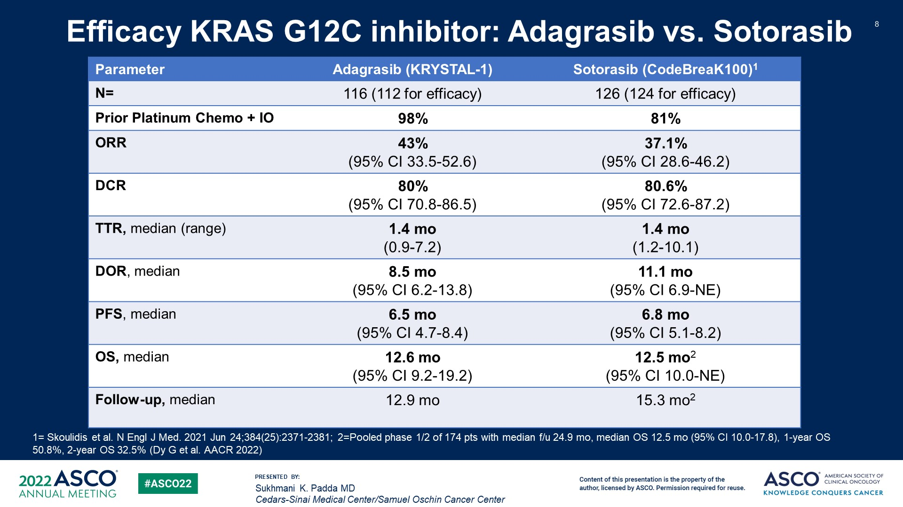
Efficacy KRAS G12C inhibitor: Adagrasib vs. Sotorasib
Content of this presentation is the property of the author, licensed by ASCO. Permission required for reuse.

Slide 20
Treatment-Related Adverse Events
 | Adagrasib Monotherapy (N=116) Capsule, Fasted
TRAEs, n (%) | Any Grade | Grades 3–4
Any TRAEs | 113 (97%) | 50 (43%)
Most frequent TRAEsª, n (%)
Diarrhea | 73 (63%) | 1 (<1%)
Nausea | 72 (62%) | 5 (4%)
Vomiting | 55 (47%) | 1 (<1%)
Fatigue | 47 (41%) | 5 (4%)
ALT increase | 32 (28%) | 5 (4%)
Blood creatinine increase | 30 (26%) | 1 (<1%)
AST increase | 29 (25%) | 4 (3%)
Decreased appetite | 28 (24%) | 4 (3%)
Grade 1–2 TRAEs occurred in 53% of patients
There were 2 grade 5 TRAEs (cardiac failure [n=1] and pulmonary hemorrhage [n=1])
TRAEs led to dose reduction in 60/116 (52%) patients^{b} and to dose interruption in 71/116 (61%) patients
TRAEs led to discontinuation of study drug in 8/116 (7%) patients
ªOccurring in >20% of patients (any grade), TRAEs occurring in >15% and <20% of patients were anemia (21 [18%]), amylase increase (20 [17%]) and QT prolongation (19 [16%]); ^{b}Percentage of patients who experienced dose reductions: 400 mg BID (33%), 600 mg QD (11%), 200 mg BID/400 mg QD (14%)
Data as of October 15, 2021 (median follow-up: 12.9 months)

Slide 21
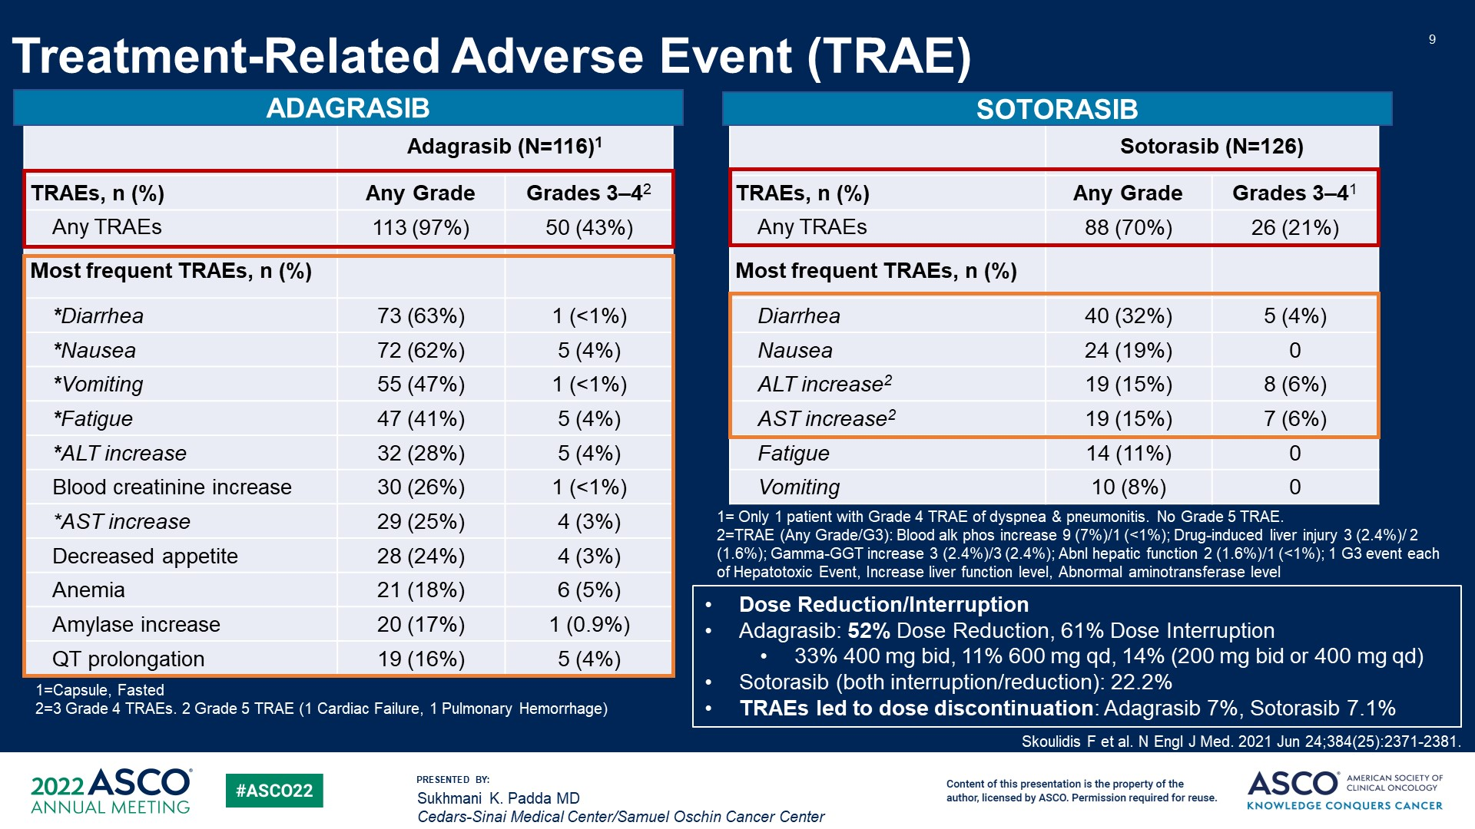
Treatment-Related Adverse Event (TRAE)
Content of this presentation is the property of the author, licensed by ASCO. Permission required for reuse.

Slide 22
Adagrasib in Previously Treated Patients with KRAS^{G12C}-mutated NSCLC: Intracranial Response in Patients with Treated, Stable CNS Metastasesª
Evaluable Patients with Target Lesions at Baseline (n=13)
20
PD
SD
Best Overall Response | Overall (n=33)^{b} | Patients with Non-target Lesions Only (n=19) | Patients with Target Lesions (n=13)^{c}
IC ORR, n (%) | 11 (33%) | 4 (21%) | 7 (54%)
Complete response | 5 (15%) | 4 (21%) | 1 (8%)
Partial response | 6 (18%) | - | 6 (46%)
Stable disease | 17 (52%) | 13 (68%) | 4 (31%)
IC DCR, n (%) | 28 (85%) | 17 (89%) | 11 (85%)
PD
0
-20
-40
SD
Maximum % Change From Baseline
PR
SD
-60
PR
PR
PR
-80
PR
SD
-100
PR
CR
IC ORR by modified RANO-BM was 33% (95% CI, 18–52); median IC DOR was 11.2 months (95% CI, 3.0–NE)
IC DCR was 85% (95% CI, 68–95); median IC PFS was 5.4 months (95% CI, 3.3–11.6)
Target lesions: all measurable lesions (size ≥5 mm) with ≤5 lesions in total, and representative of all involved organs; non-target lesions: all non-measurable lesions and measurable lesions not identified as target lesions ªAmong patients with adequately treated, stable CNS metastases, 33 patients were radiographically evaluable (i.e., had a baseline and on-treatment brain scan for evaluation), of whom 27 (82%) received radiation prior to adagrasib treatment (59% <3 months before study entry and 37% ≥6 months before study entry); ^{b}One patient with tumor shrinkage of 8% was deemed to be ‘not evaluable’ as the post-baseline scan was performed too early for evaluation; ^{c}Patients with target lesions may have also had non-target lesions
Data as of December 31, 2021 (median follow-up: 15.4 months)

Slide 23

Activity of Adagrasib (MRTX849) in Patients with KRAS^{G12C}-Mutated NSCLC and Active, Untreated CNS Metastases in the KRYSTAL-1 Trial
Joshua K. Sabari,¹ Alexander I. Spira,² Rebecca S. Heist,³ Pasi A. Jänne,⁴ Jose M. Pacheco,⁵ Jared Weiss,⁶ Shirish M. Gadgeel,⁷ Hirak Der-Torossian,⁸ Karen Velastegui,⁸ Thian Kheoh,⁸ James G. Christensen,⁸ Marcelo V. Negrao⁹
¹Perlmutter Cancer Center, New York University Langone Health, New York, NY; ²Virginia Cancer Specialists, Fairfax, VA; US Oncology Research, The Woodlands, TX; NEXT Oncology, VA; ³Massachusetts General Hospital, Boston, MA; ⁴Dana-Farber Cancer Institute, Boston, MA; ⁵Division of Medical Oncology, Department of Medicine, University of Colorado Anschutz Medical Campus, Aurora, CO; ⁶Lineberger Comprehensive Cancer Center, University of North Carolina-Chapel Hill, Chapel Hill, NC; ⁷Henry Ford Cancer Institute, Detroit, MI; ⁸Mirati Therapeutics, Inc., San Diego, CA; ⁹Department of Thoracic/Head & Neck Medical Oncology, MD Anderson Cancer Center, University of Texas, Houston, TX
Dr Joshua K. Sabari

Slide 24
Adagrasib in Patients with Active, Untreated CNS Metastases: Intracranial Best Tumor Change From Baseline
20
SD
PD
0
-20
SD
SD
SD
Maximum % Change from Baseline
SD
-40
PR*
-60
SD
-80
PR
PR
-100
SD†
SD‡
PD§
CR
Objective IC responses were observed in 32% (95% CI, 12.6–56.6)ª
IC DCR was 84% (95% CI, 60.4–96.6)
All results are based on BICR (mRANO-BM criteria). Only patients with target lesions and ≥1 post-baseline scans are shown; 1 patient not evaluable for best overall response due to scans being too early (100% regression in target lesions) *Unconfirmed at data cut-off, confirmed CR after data cut-off; †SD due to non-target lesion progression; ‡Unconfirmed CR due to no subsequent scan; §PD due to new lesions ªIncludes patients with target and non-target lesions
Data as of December 31, 2021 (median follow-up: 6.6 months)

Slide 25
Adagrasib in Patients with Active, Untreated CNS Metastases: Concordance of Intracranial and Systemic Disease Control
Efficacy Outcome | Intracranial BOR | Systemic BOR
Patient 1 | PR | PRª
Patient 2 | SD | PRª
Patient 3 | SD | SD
Patient 4 | SD | SD
Patient 5 | SD | PR
Patient 6 | PD | SD
Patient 7 | SD | PR
Patient 8 | PR | SD
Patient 9 | PD | PD
Patient 10 | CR | SD
Efficacy Outcome | Intracranial BOR | Systemic BOR
Patient 11 | SD | SD
Patient 12 | SD | PR
Patient 13 | CR | SD
Patient 14 | SD | SD
Patient 15 | PR^{b} | PR^{c}
Patient 16 | SD | PD
Patient 17 | CR | PR
Patient 18 | NE | NE
Patient 19 | SD | NE
Concordant disease control
Discordant disease control
Concordance between systemic and intracranial disease control was 88% (14/16)
Systemic ORR by RECIST v1.1 was 37% (95% CI, 16.3–61.6); systemic DCR 79% (95% CI, 54.4–93.9)
All results are based on BICR (mRANO-BM, RECIST 1.1) Systemic responses in clinically evaluable population with ≥1 post-baseline assessment (n=19) ªConfirmed after data cut-off; ^{b}Unconfirmed at data cut-off, confirmed CR after data cut-off; ^{c}Unconfirmed at data cut-off, BOR of SD after data cut-off
Data as of December 31, 2021 (median follow-up: 6.6 months)

Slide 26
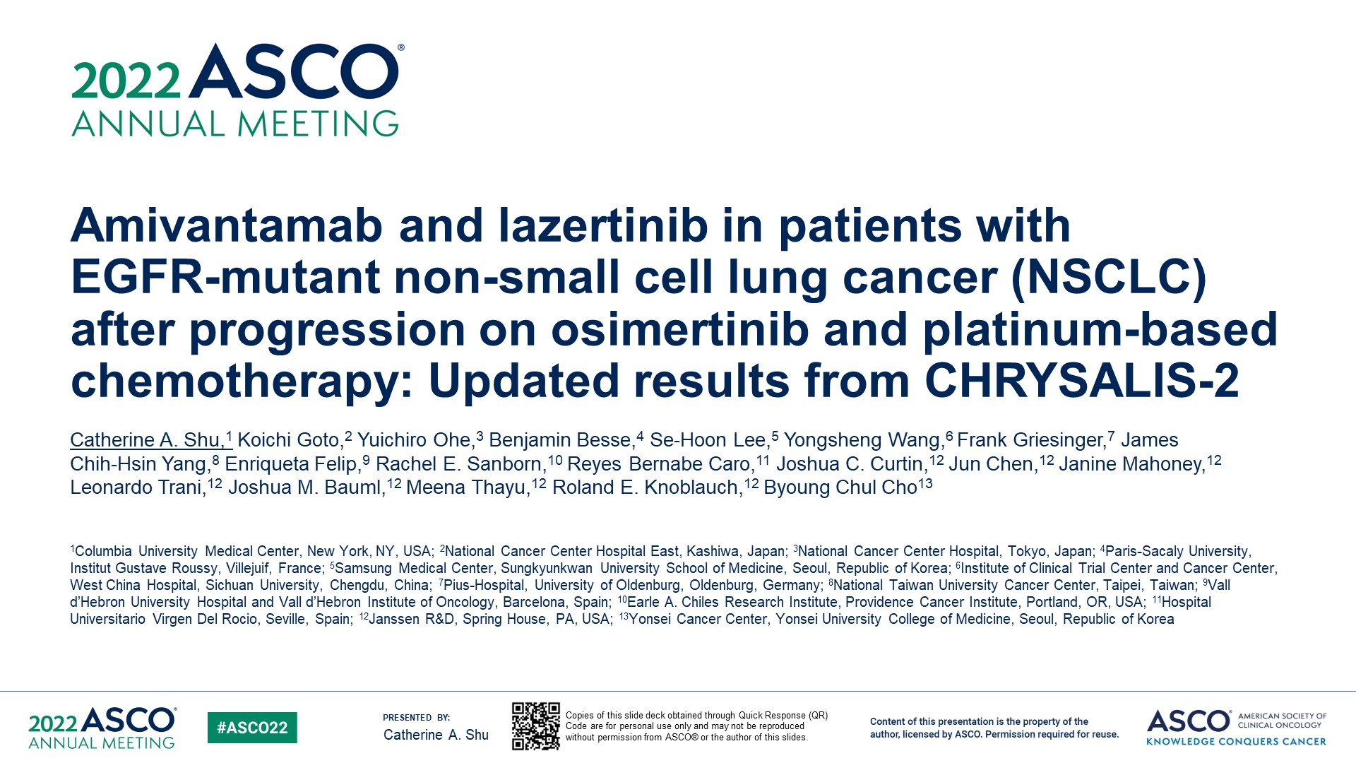
Amivantamab and lazertinib in patients with <br />EGFR-mutant non-small cell lung cancer (NSCLC) after progression on osimertinib and platinum-based chemotherapy: Updated results from CHRYSALIS-2
Content of this presentation is the property of the author, licensed by ASCO. Permission required for reuse.

Slide 27
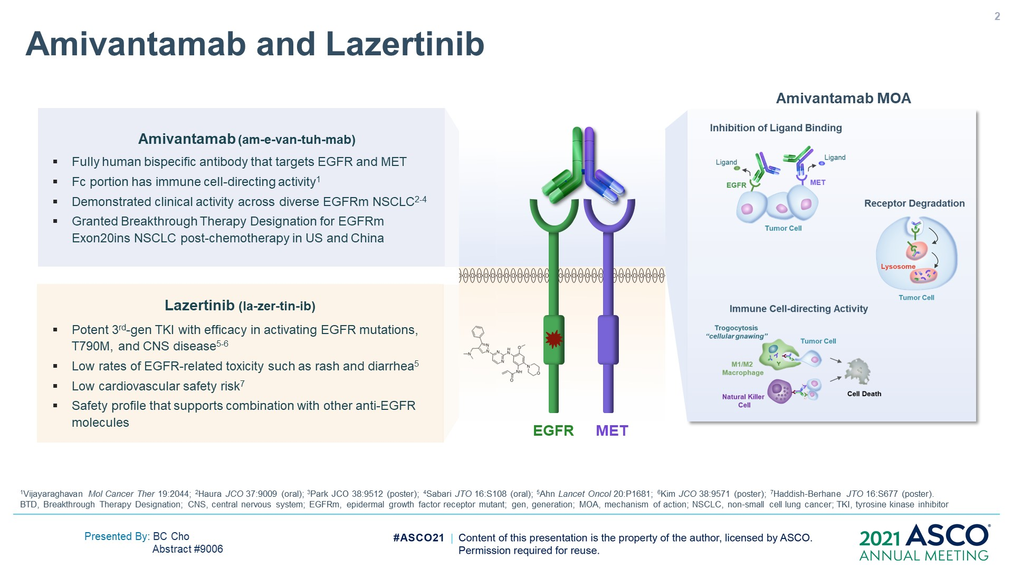
Amivantamab and Lazertinib
Content of this presentation is the property of the author, licensed by ASCO. Permission required for reuse.

Slide 28
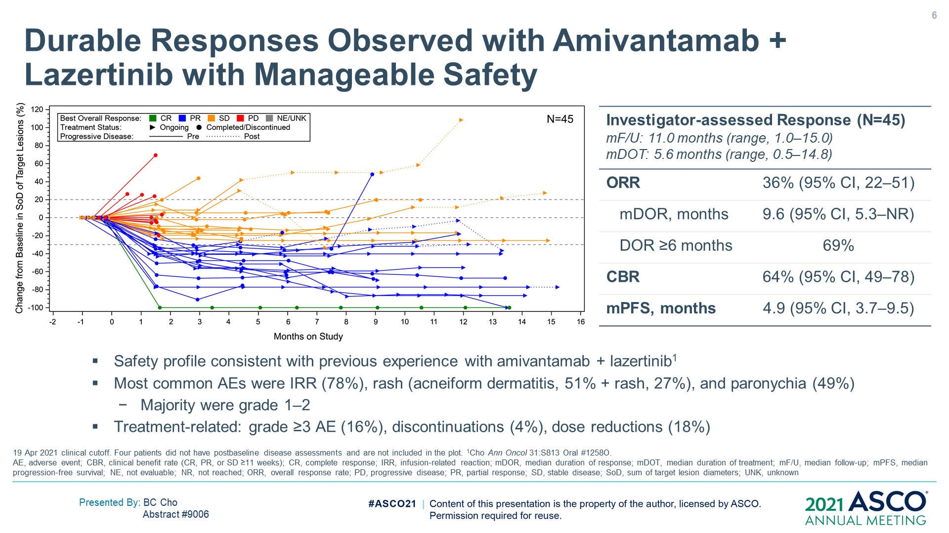
Durable Responses Observed with Amivantamab + Lazertinib with Manageable Safety
Content of this presentation is the property of the author, licensed by ASCO. Permission required for reuse.

Slide 29
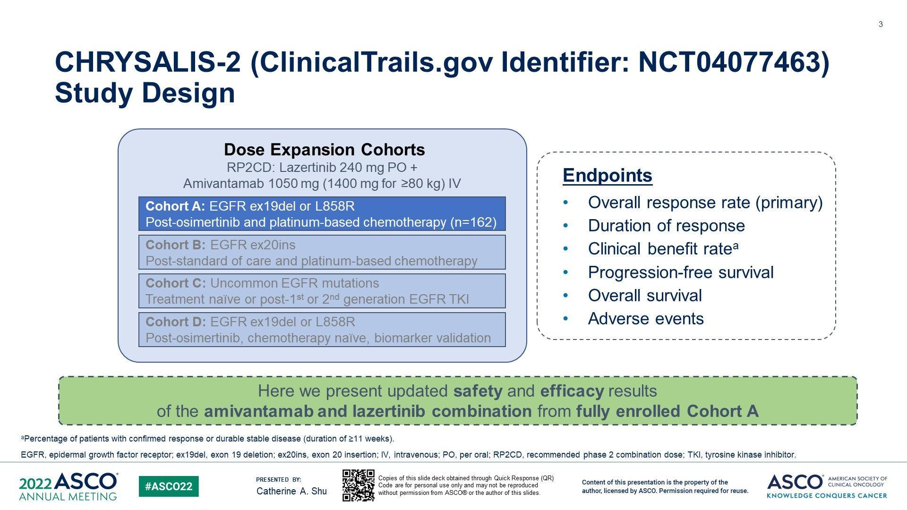
CHRYSALIS-2 (ClinicalTrails.gov Identifier: NCT04077463) Study Design
Content of this presentation is the property of the author, licensed by ASCO. Permission required for reuse.

Slide 30
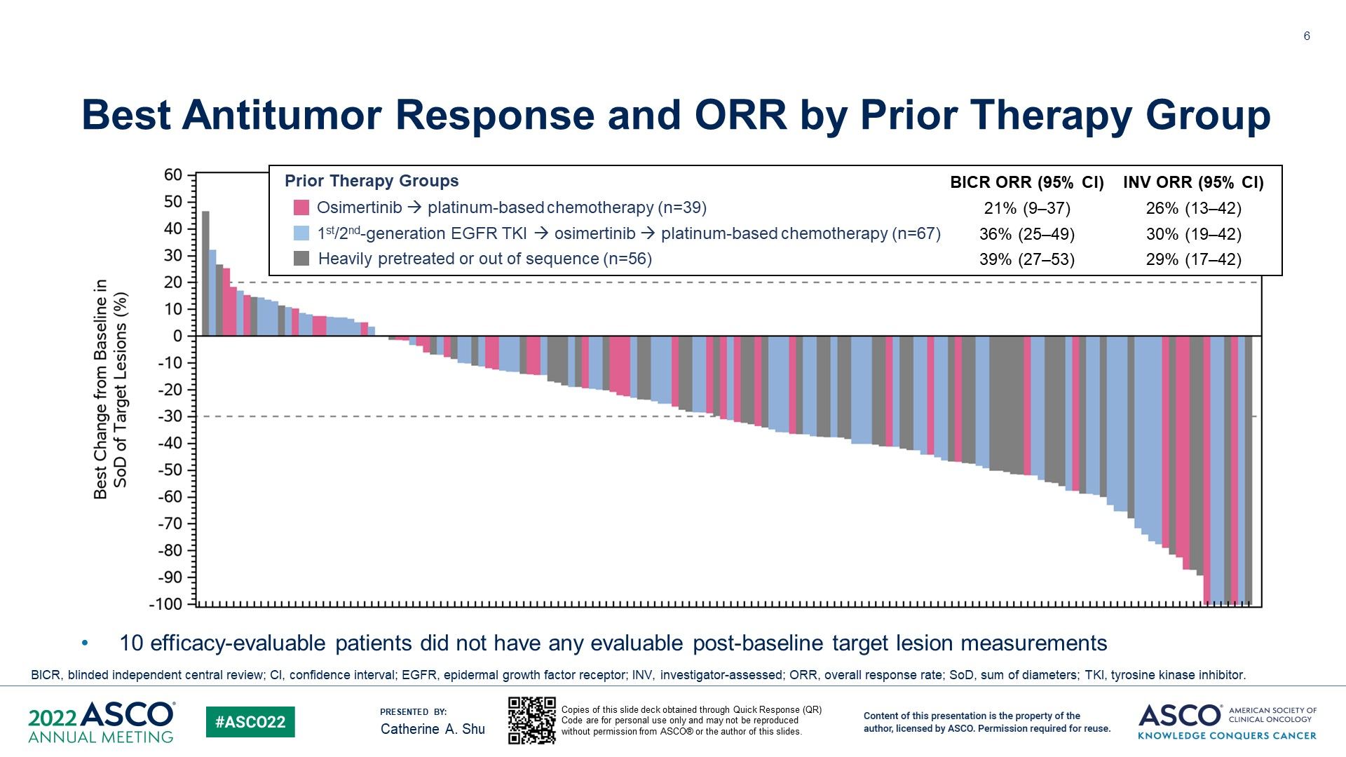
Best Antitumor Response and ORR by Prior Therapy Group
Median PFS was 5.1 months, DOR- 9.6 mo
Content of this presentation is the property of the author, licensed by ASCO. Permission required for reuse.

Slide 31
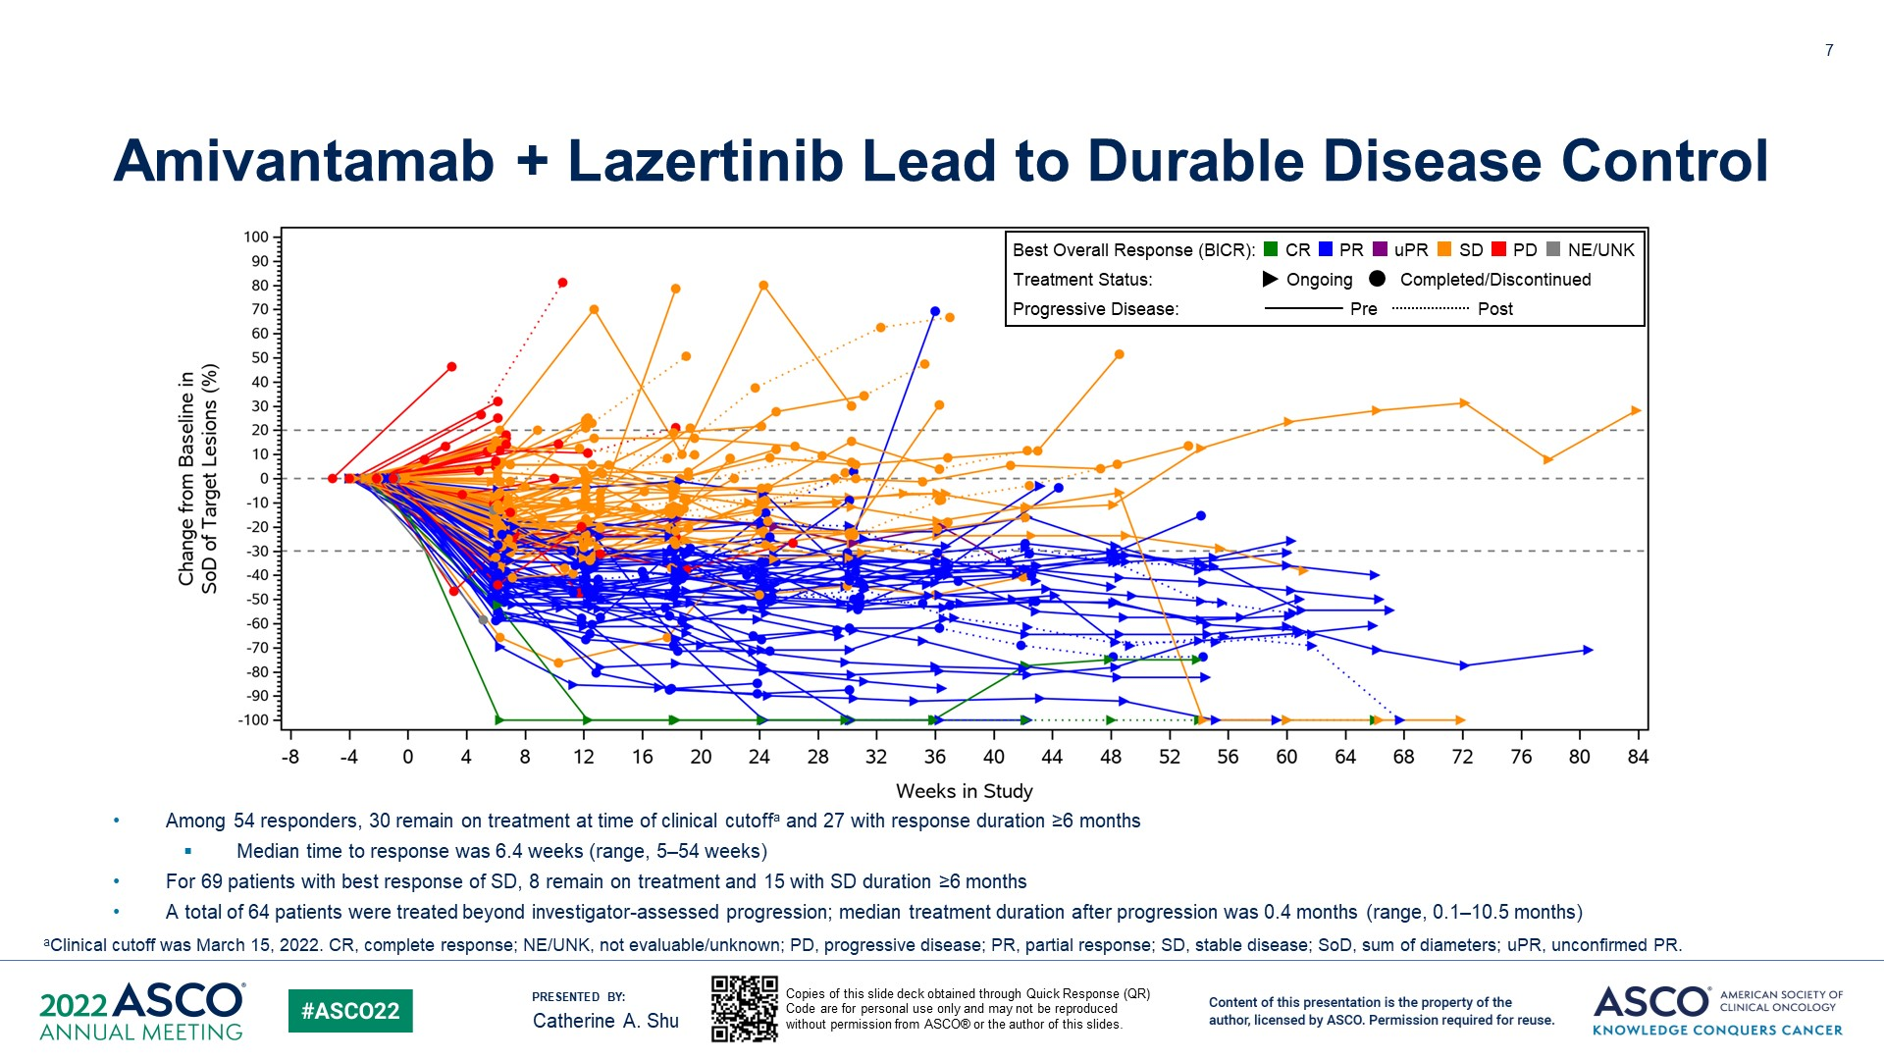
Amivantamab + Lazertinib Lead to Durable Disease Control
Content of this presentation is the property of the author, licensed by ASCO. Permission required for reuse.

Slide 32
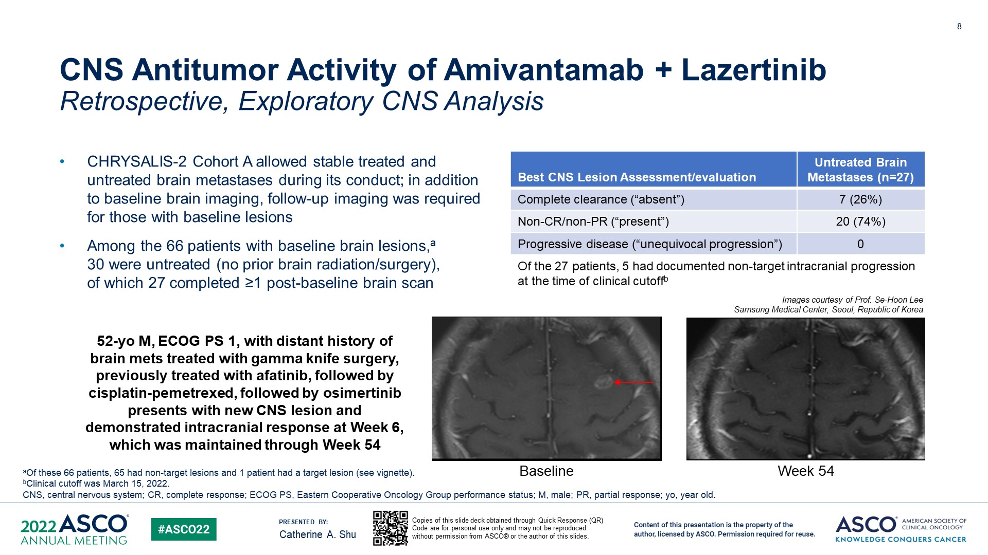
CNS Antitumor Activity of Amivantamab + Lazertinib<br />Retrospective, Exploratory CNS Analysis
Content of this presentation is the property of the author, licensed by ASCO. Permission required for reuse.

Slide 33
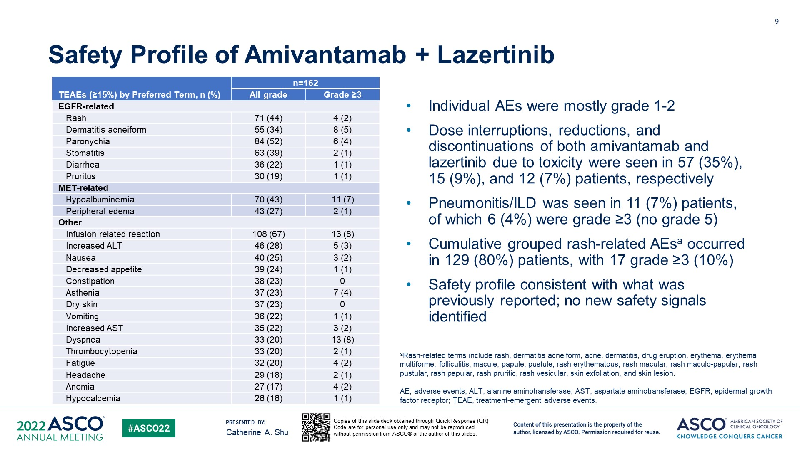
Safety Profile of Amivantamab + Lazertinib<br />
Content of this presentation is the property of the author, licensed by ASCO. Permission required for reuse.

Slide 34
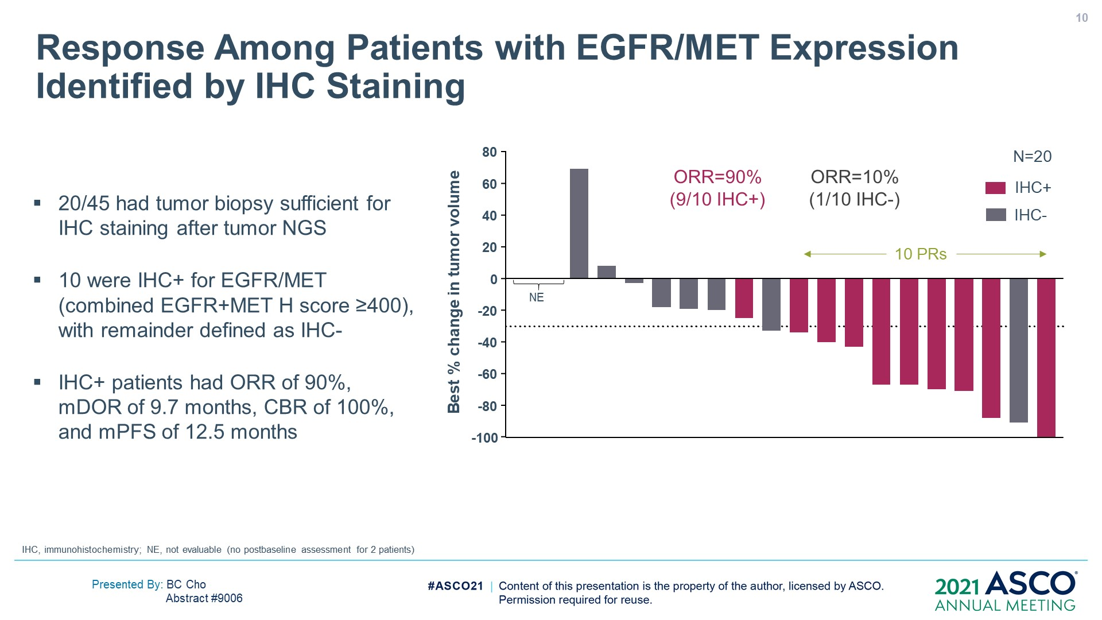
Slide 10
Content of this presentation is the property of the author, licensed by ASCO. Permission required for reuse.

Slide 35
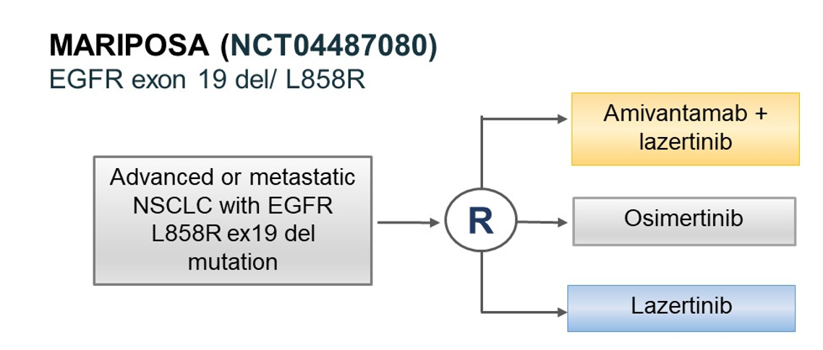
What to do Today and Future?
Should the combination of amivantamab and osimertinib be considered?
Prefer clinical trials with ADCs (patritumab deruxtecan), newer EGFR-TKIs and novel immunotherapies, Further assessment of biomarkers
Should the combination be considered in front-line

Slide 36
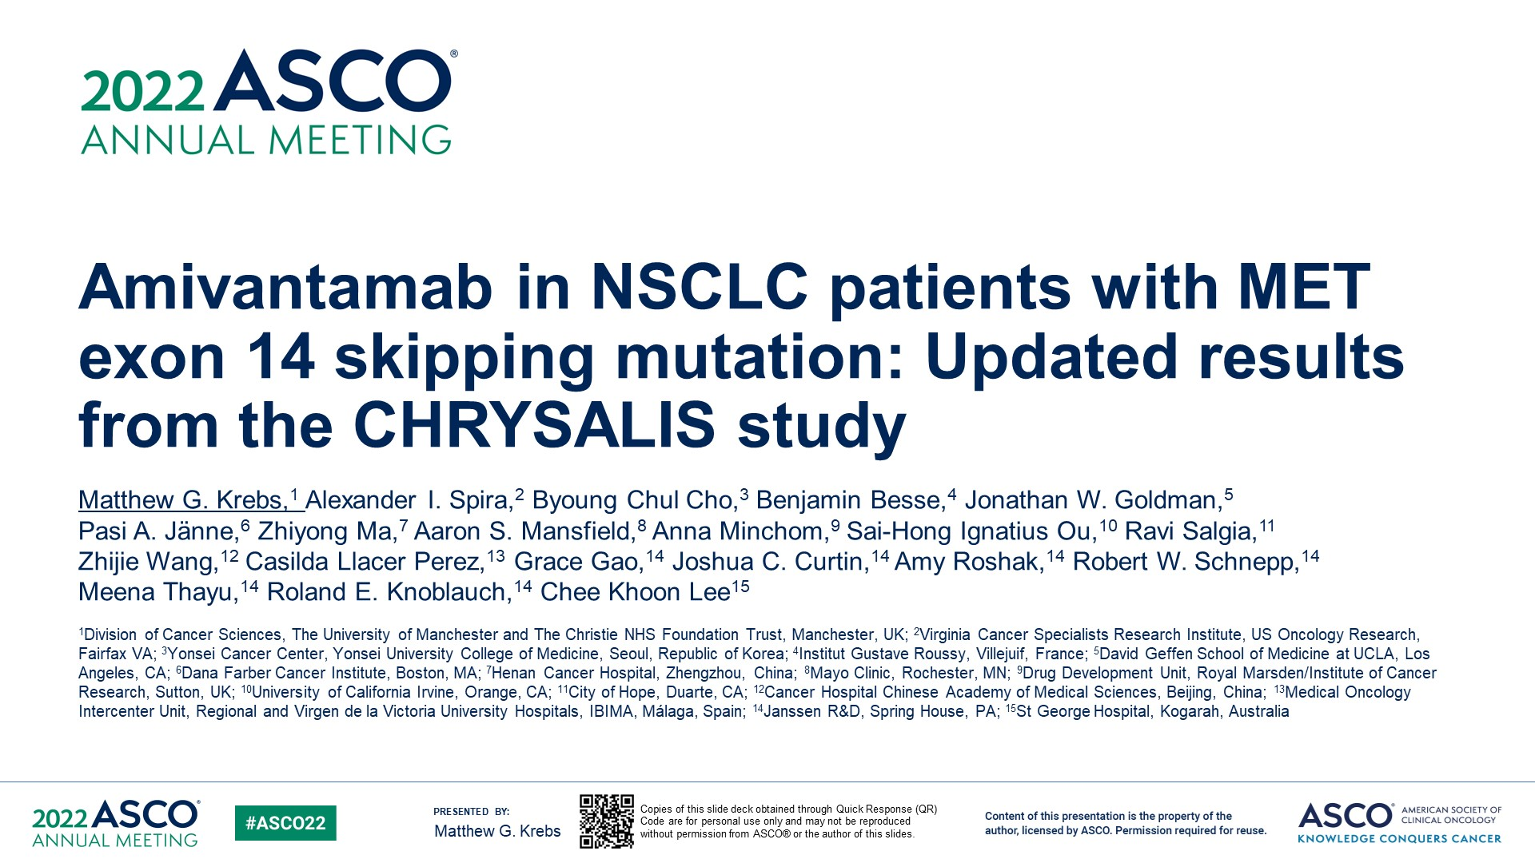
Amivantamab in NSCLC patients with MET exon 14 skipping mutation: Updated results from the CHRYSALIS study
Content of this presentation is the property of the author, licensed by ASCO. Permission required for reuse.

Slide 37
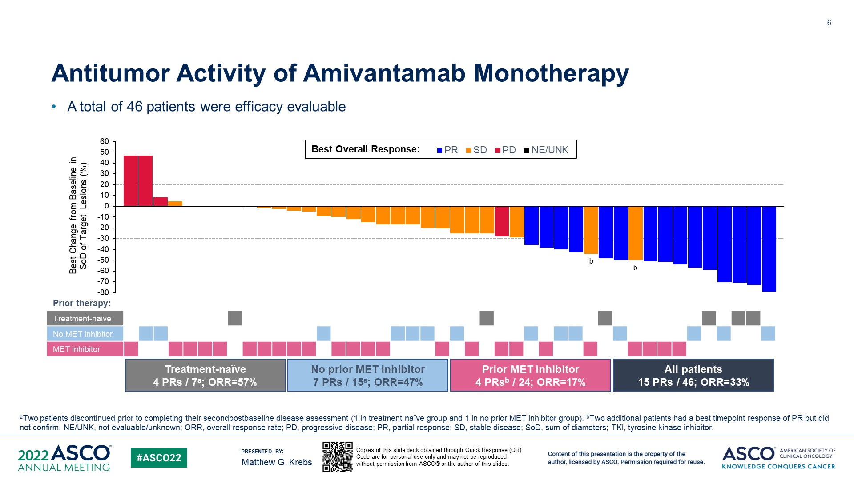
Antitumor Activity of Amivantamab Monotherapy
Content of this presentation is the property of the author, licensed by ASCO. Permission required for reuse.

Slide 38
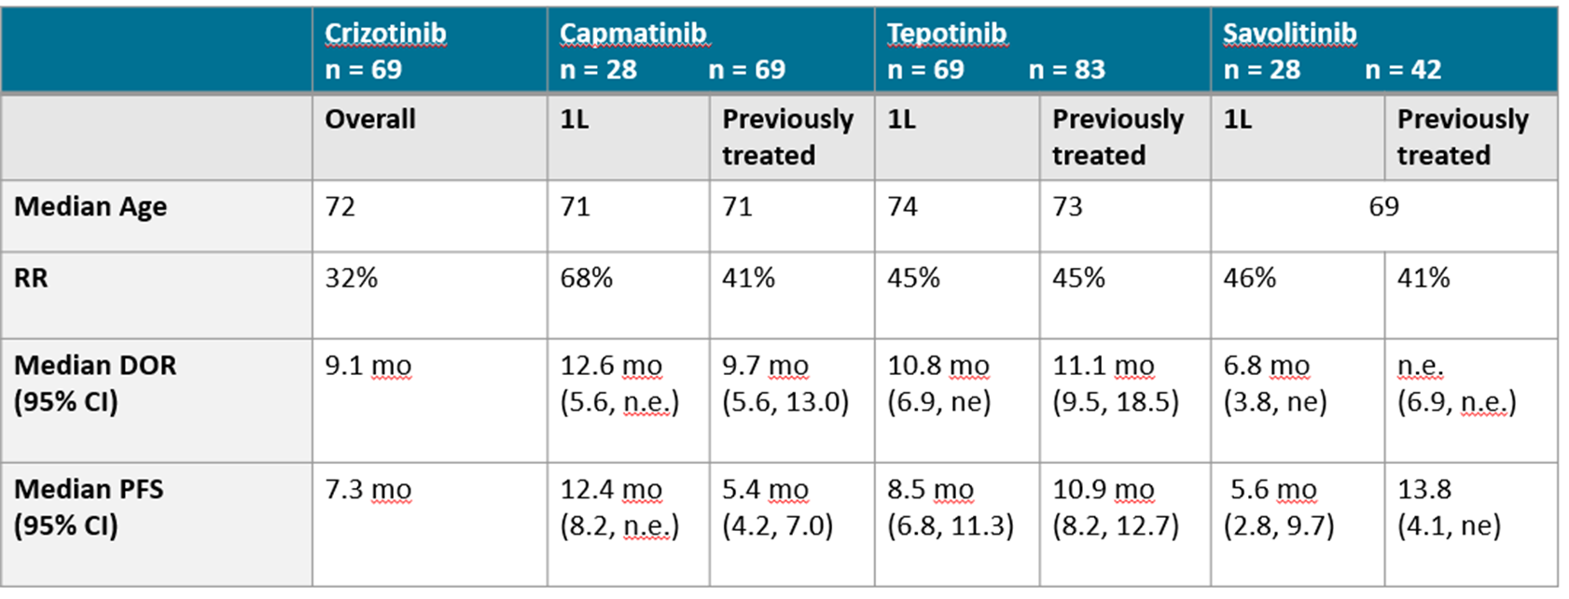
MET TKIs
Amivantamab- 1L- NE; No prior MET- 8.3 mo; Prior MET- 4.2 mo

Slide 39
What to Today and in the Future
Could this be an option in MET exon 14 skipping mutation in TKI treated patients? MET amplified NSCLC
Need better data in treatment naïve patients
Convenience of a pill versus IV
Combination therapy
Combining amivantamab with TKI. Concerns about tolerability

Slide 40
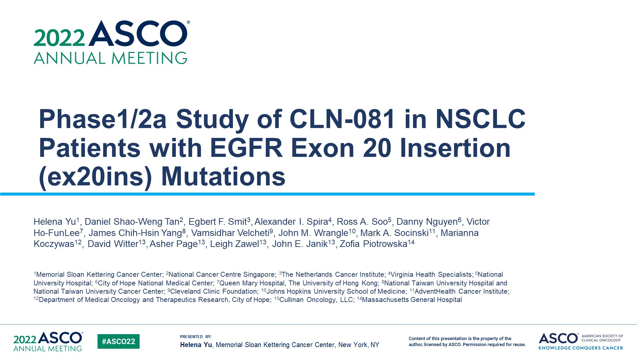
Phase1/2a Study of CLN-081 in NSCLC Patients with EGFR Exon 20 Insertion (ex20ins) Mutations
Content of this presentation is the property of the author, licensed by ASCO. Permission required for reuse.

Slide 41
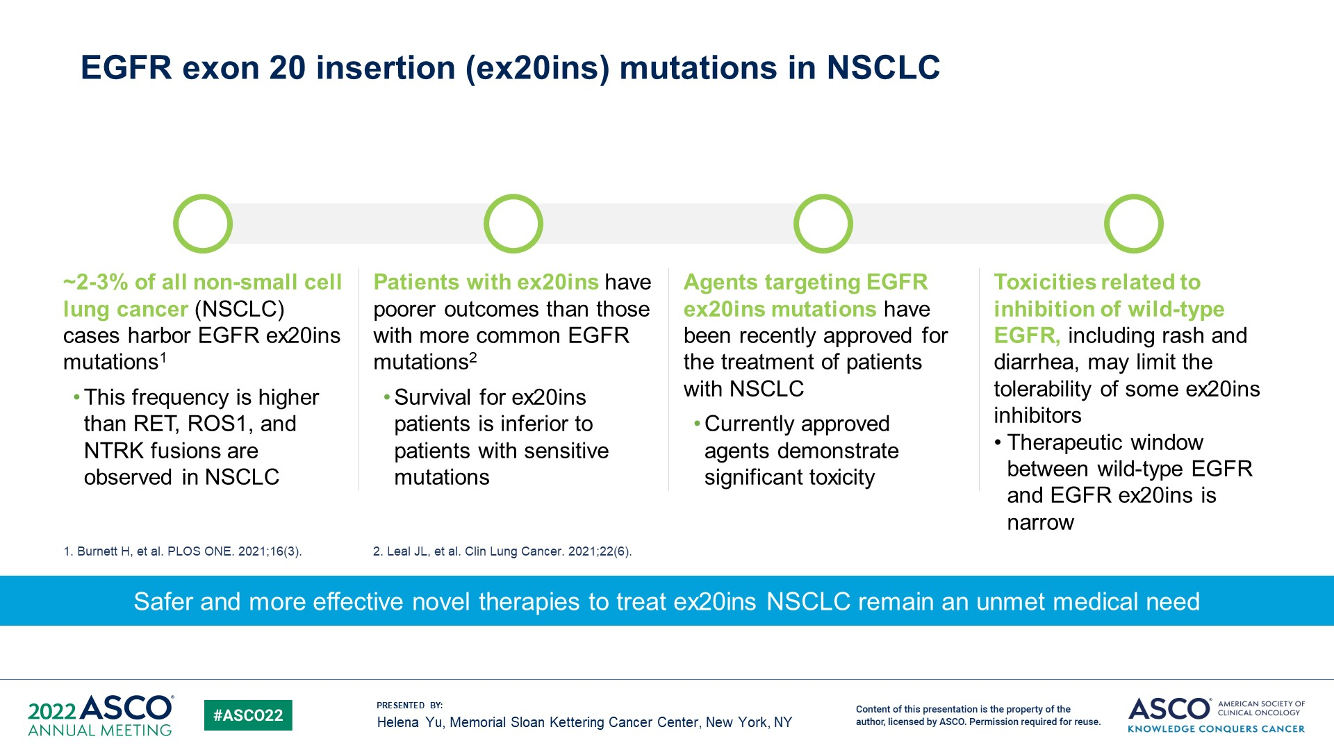
EGFR exon 20 insertion (ex20ins) mutations in NSCLC <br />
Content of this presentation is the property of the author, licensed by ASCO. Permission required for reuse.

Slide 42
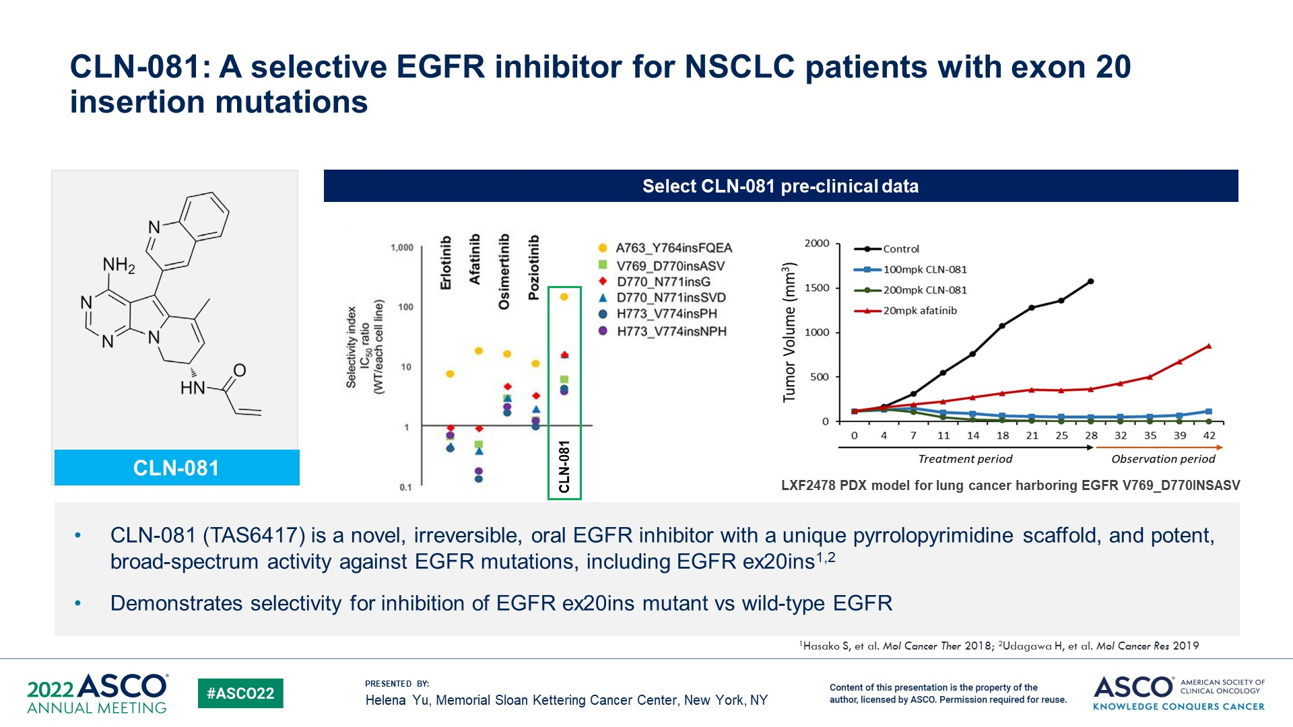
CLN-081: A selective EGFR inhibitor for NSCLC patients with exon 20 insertion mutations
Content of this presentation is the property of the author, licensed by ASCO. Permission required for reuse.

Slide 43
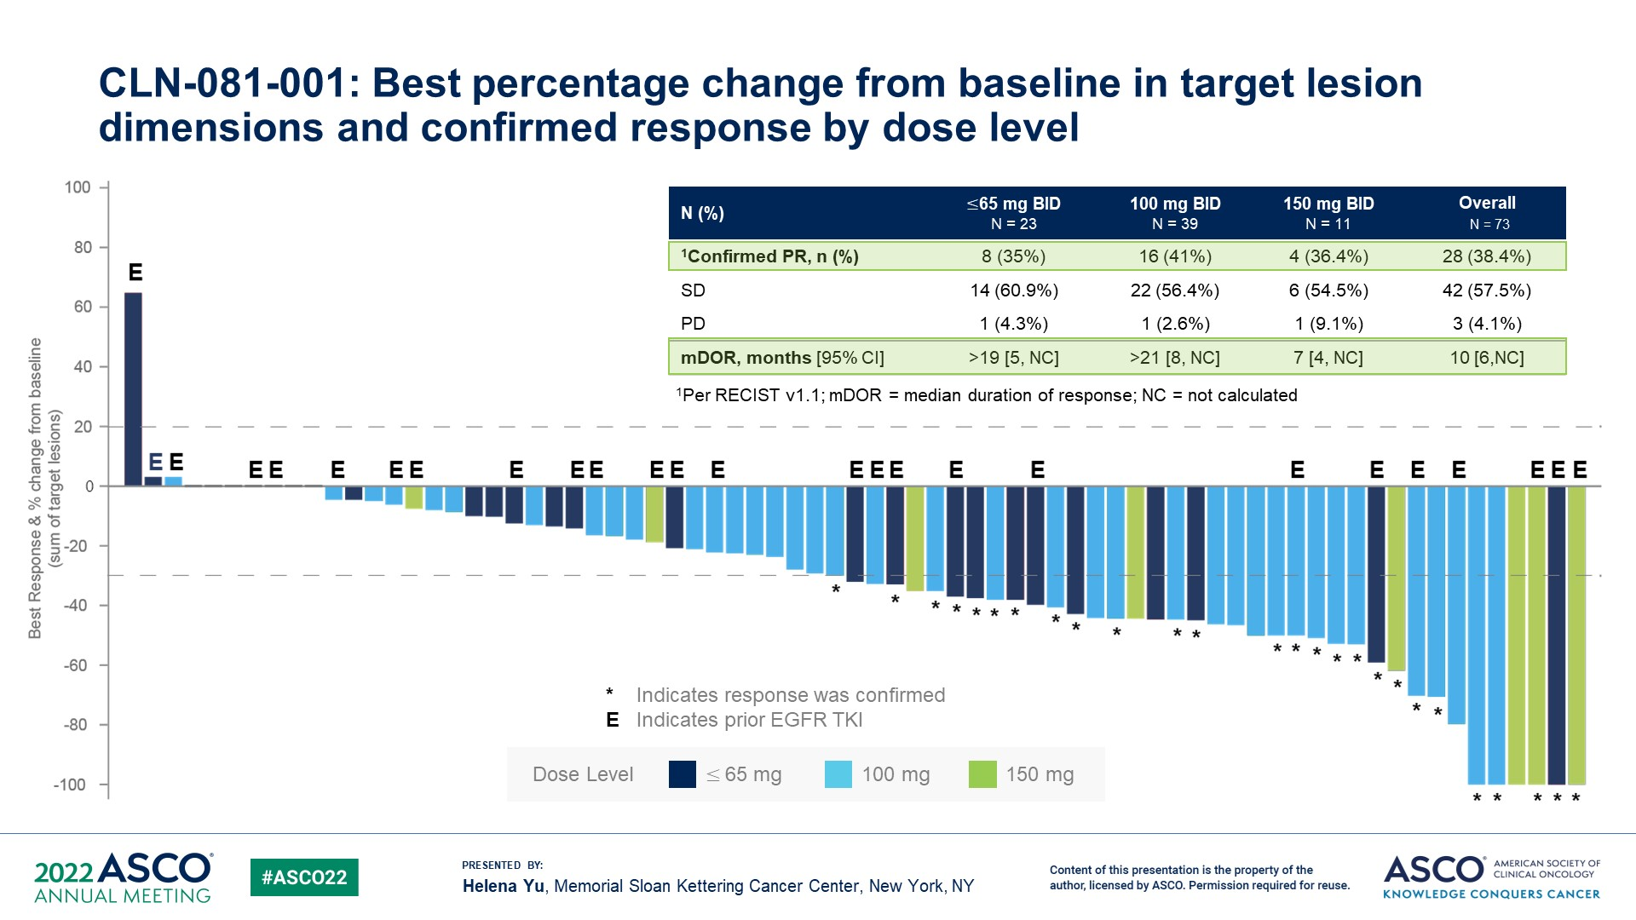
CLN-081-001: Best percentage change from baseline in target lesion dimensions and confirmed response by dose level
Content of this presentation is the property of the author, licensed by ASCO. Permission required for reuse.

Slide 44
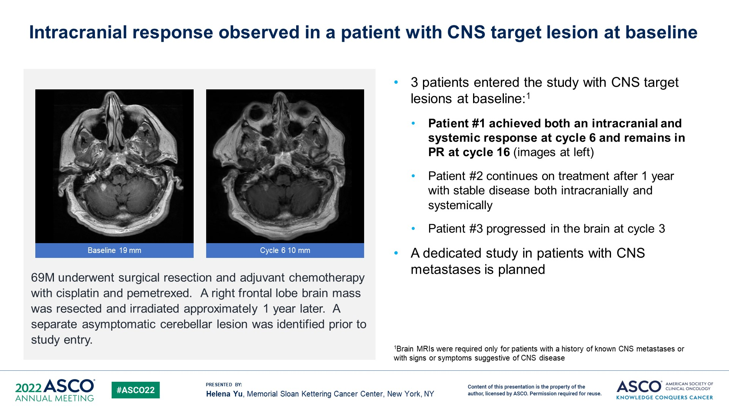
Intracranial response observed in a patient with CNS target lesion at baseline
Content of this presentation is the property of the author, licensed by ASCO. Permission required for reuse.

Slide 45
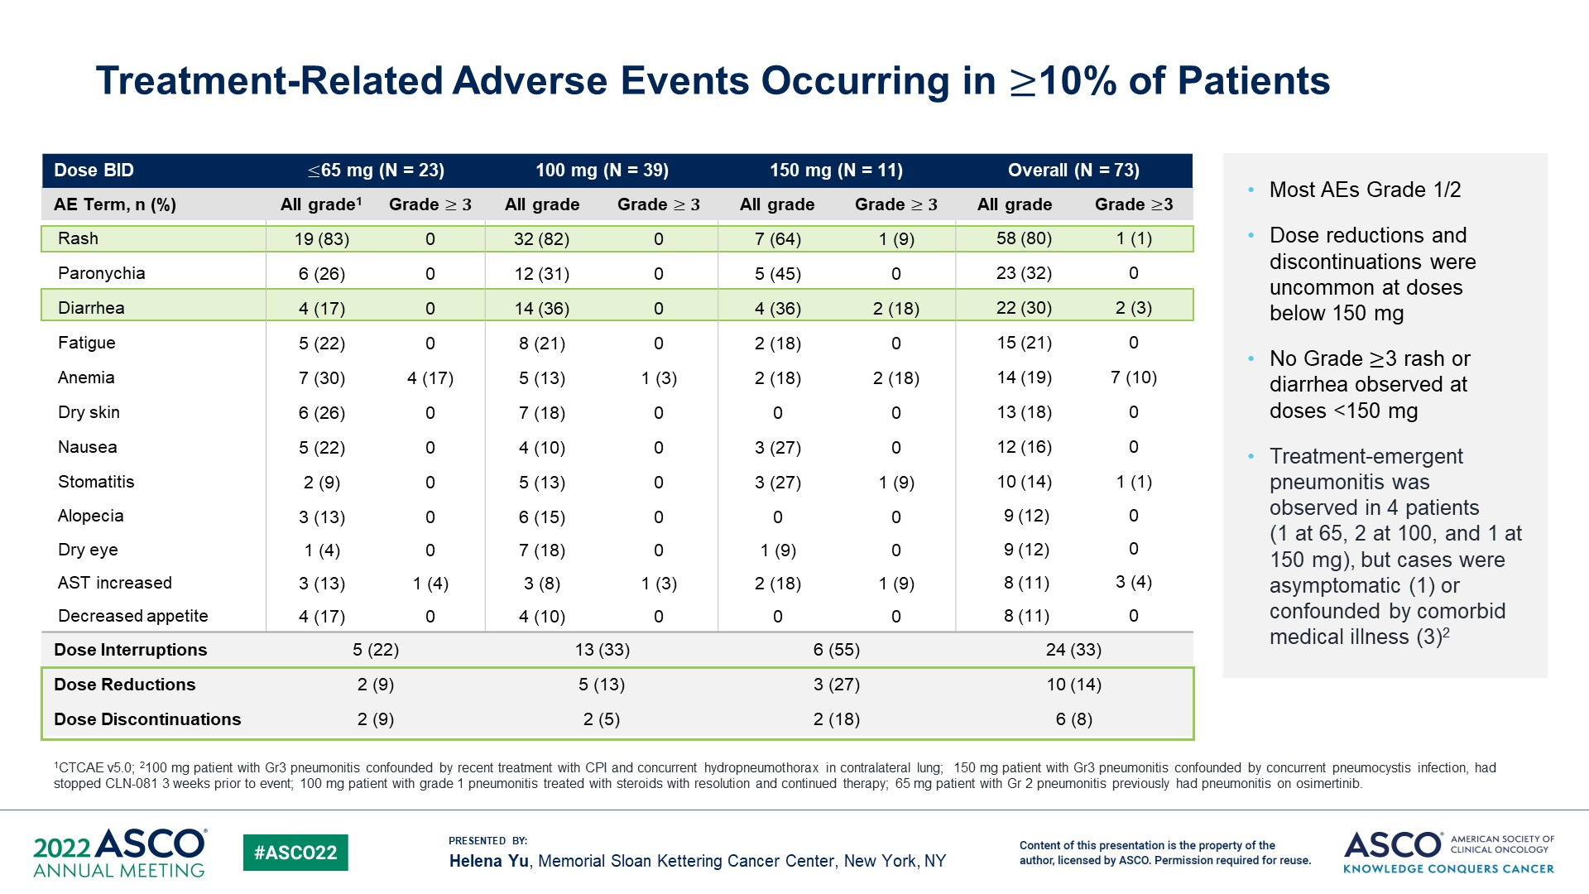
Treatment-Related Adverse Events Occurring in ≥10% of Patients
Content of this presentation is the property of the author, licensed by ASCO. Permission required for reuse.

Slide 46
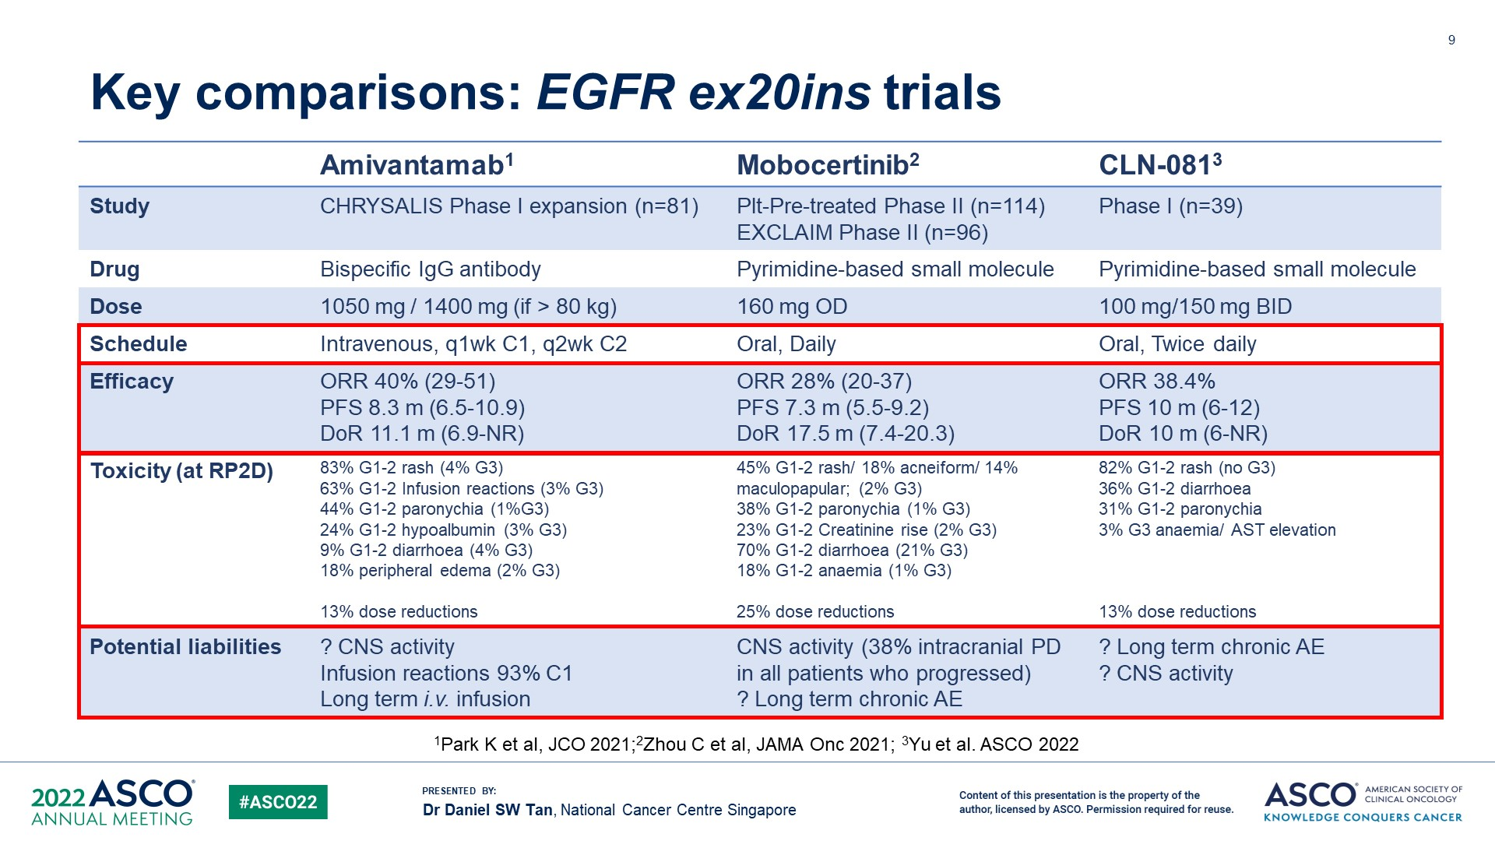
Key comparisons: EGFR ex20ins trials
Content of this presentation is the property of the author, licensed by ASCO. Permission required for reuse.

Slide 47

ASCO 2022 Highlights—Immunotherapy
Karen Reckamp, MD, MS
Professor of Medicine
Director, Division of Medical Oncology
Associate Director, Clinical Research
Cedars-Sinai, Los Angeles, USA
Karen L. Reckamp, MD, MS

Slide 48
Immunotherapy highlights 2022
8501—Nivolumab + chemotherapy versus chemotherapy as neoadjuvant treatment for resectable stage IIIA NSCLC: Primary endpoint results of pathological complete response (pCR) from phase II NADIM II trial
9000—Outcomes of anti–PD-(L)1 therapy with or without chemotherapy (chemo) for first-line (1L) treatment of advanced non–small cell lung cancer (NSCLC) with PD-L1 score ≥ 50%: FDA pooled analysis
9010—Updated analysis from the ATEZO-BRAIN trial: Atezolizumab plus carboplatin and pemetrexed in patients with advanced nonsquamous non–small cell lung cancer with untreated brain metastases
9004—Overall survival from a phase II randomized study of ramucirumab plus pembrolizumab versus standard of care for advanced non–small cell lung cancer previously treated with immunotherapy: Lung-MAP nonmatched substudy S1800A
9005—Cabozantinib (C) plus atezolizumab (A) or C alone in patients (pts) with advanced non–small cell lung cancer (aNSCLC) previously treated with an immune checkpoint inhibitor (ICI): Results from Cohorts 7 and 20 of the COSMIC-021 study
LBA8507—SKYSCRAPER-02: Primary results of a phase III, randomized, double-blind, placebo-controlled study of atezolizumab (atezo) + carboplatin + etoposide (CE) with or without tiragolumab (tira) in patients (pts) with untreated extensive-stage small cell lung cancer (ES-SCLC)

Slide 49
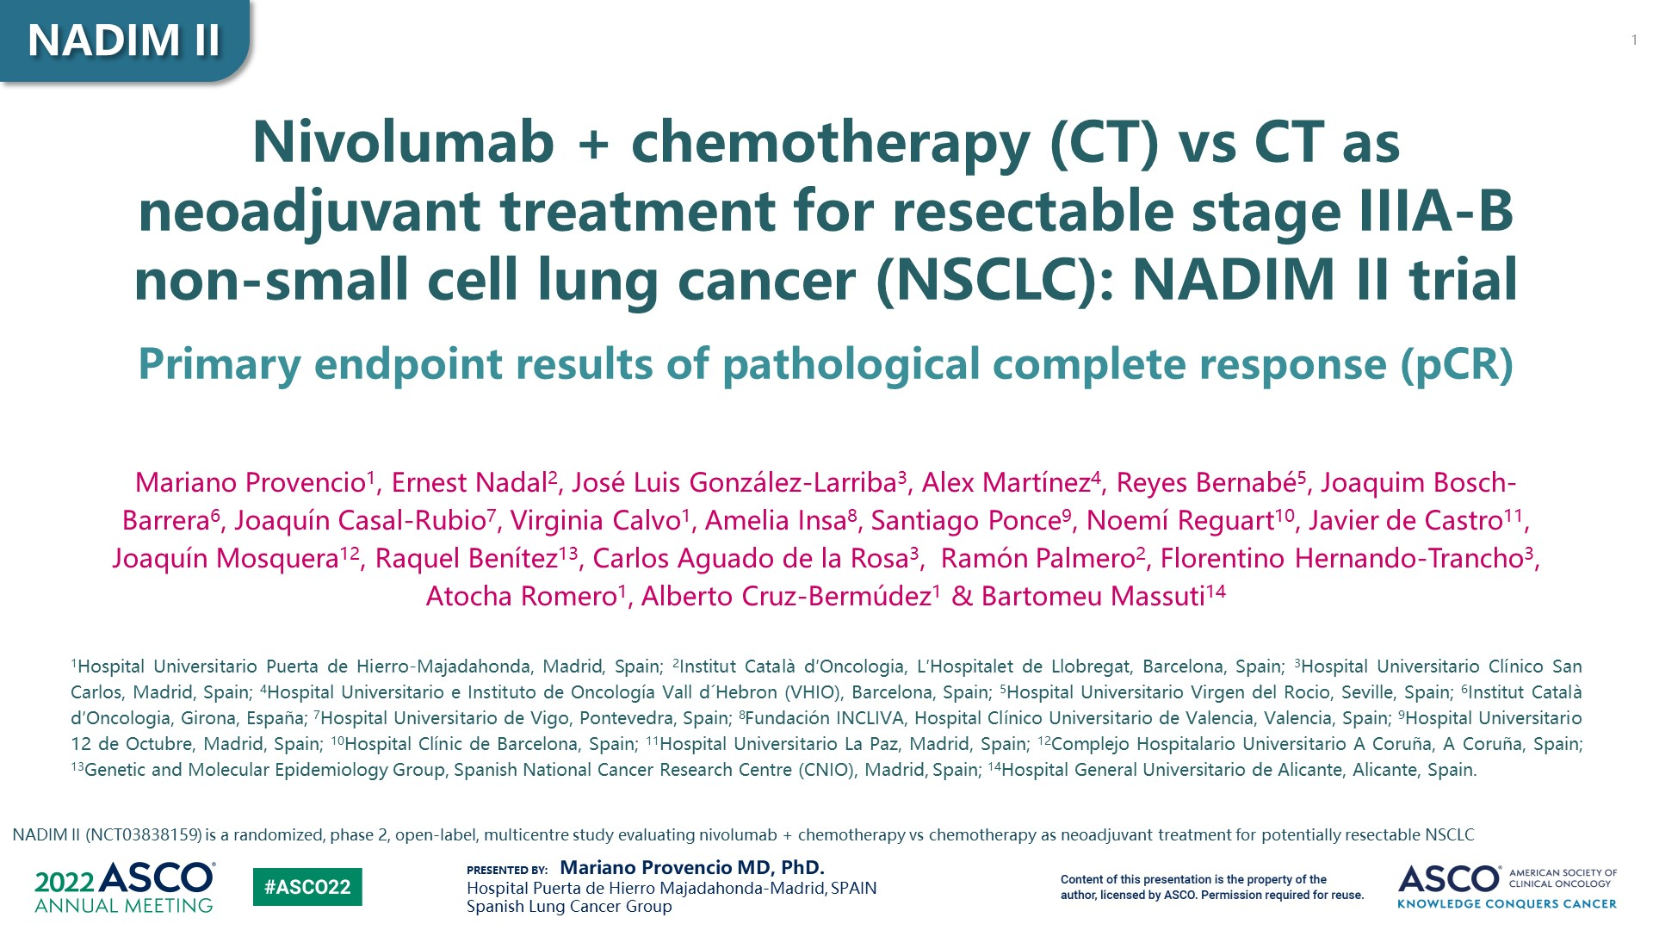
Slide 1

Slide 50
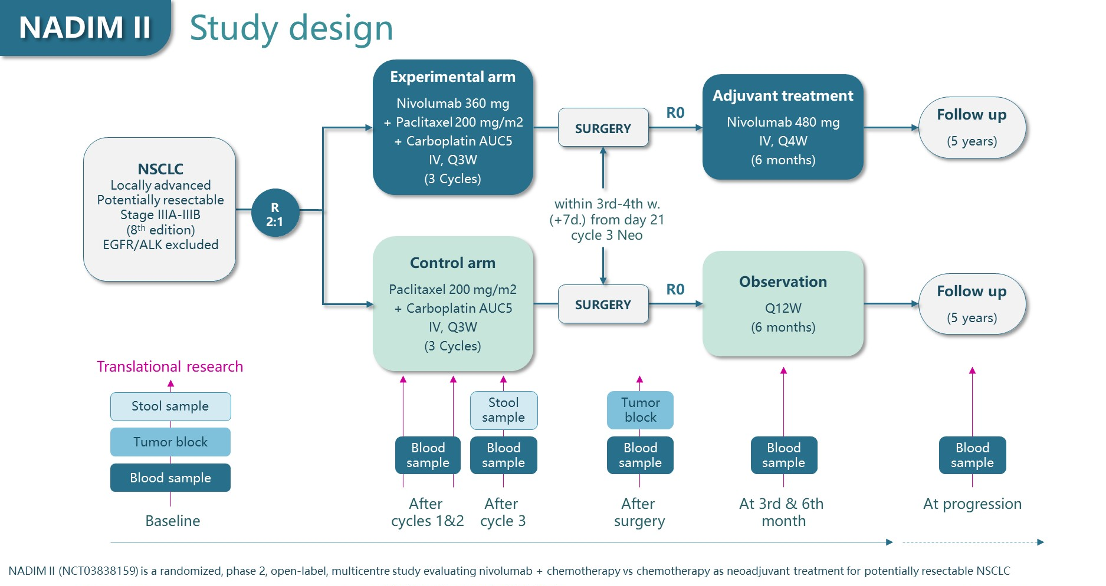
Slide 4

Slide 51
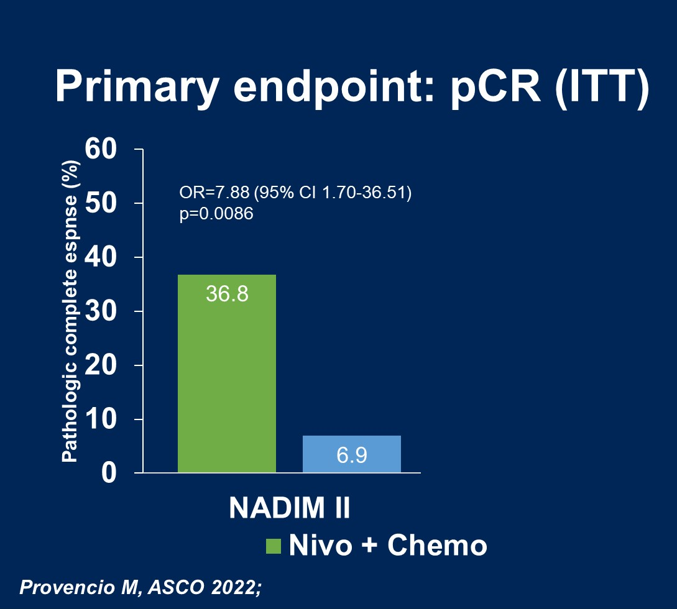
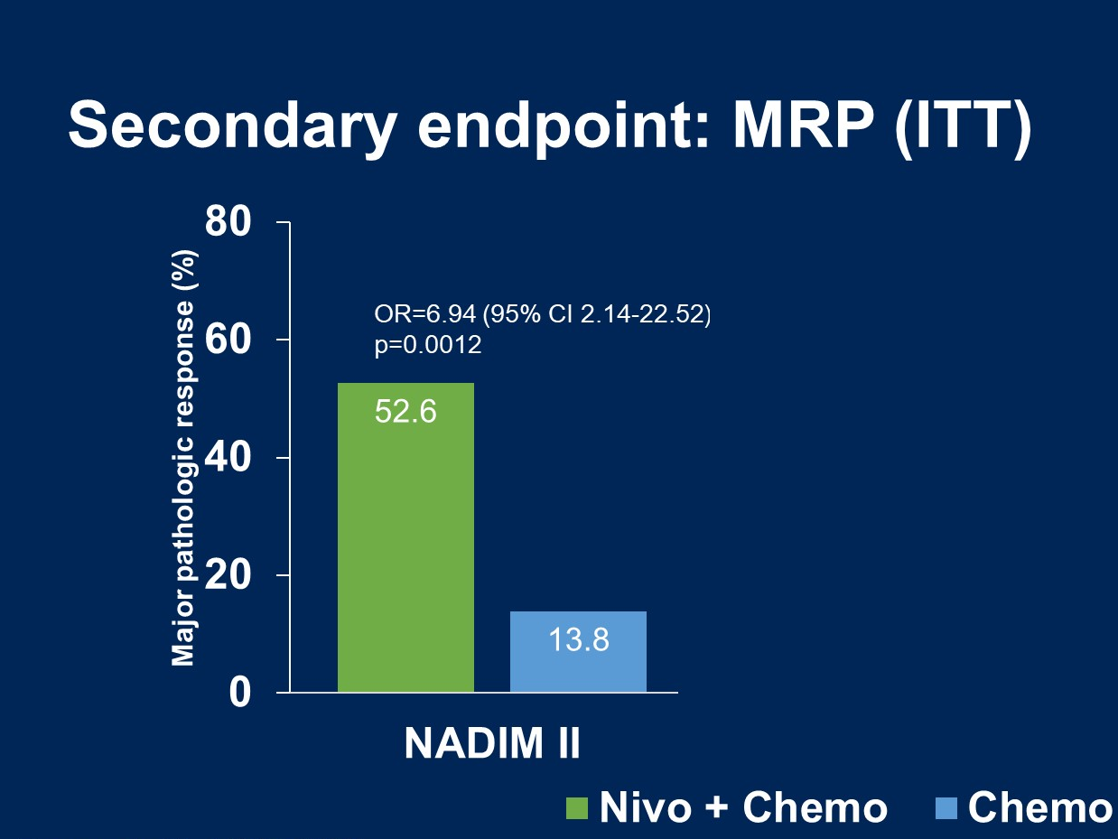
NADIM II—Efficacy outcomes

Slide 52
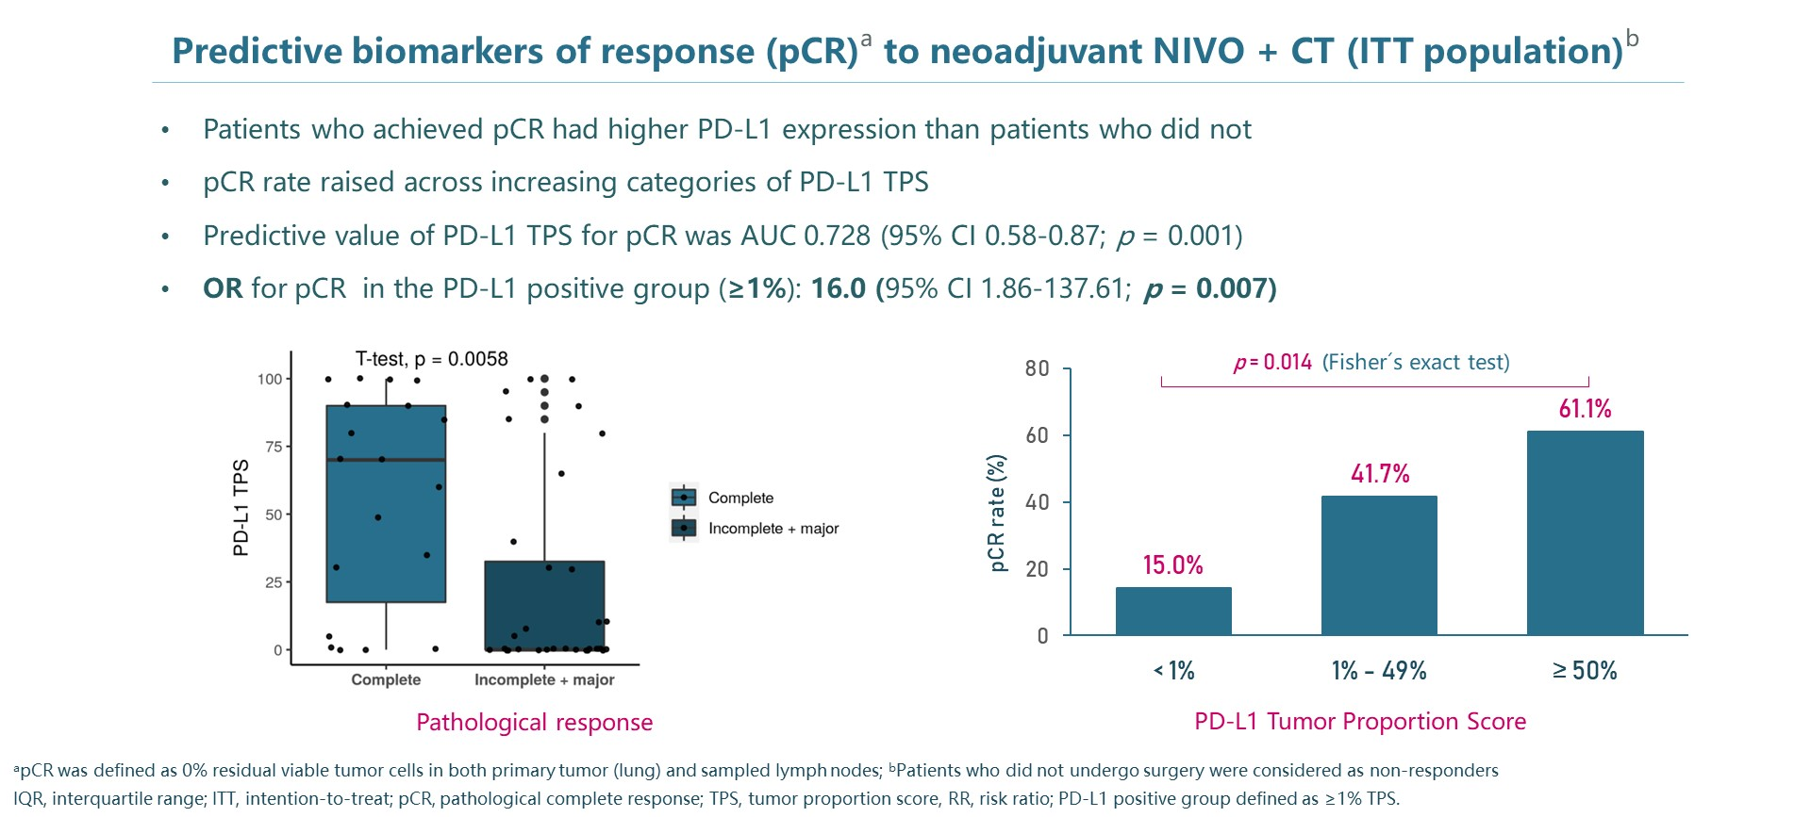
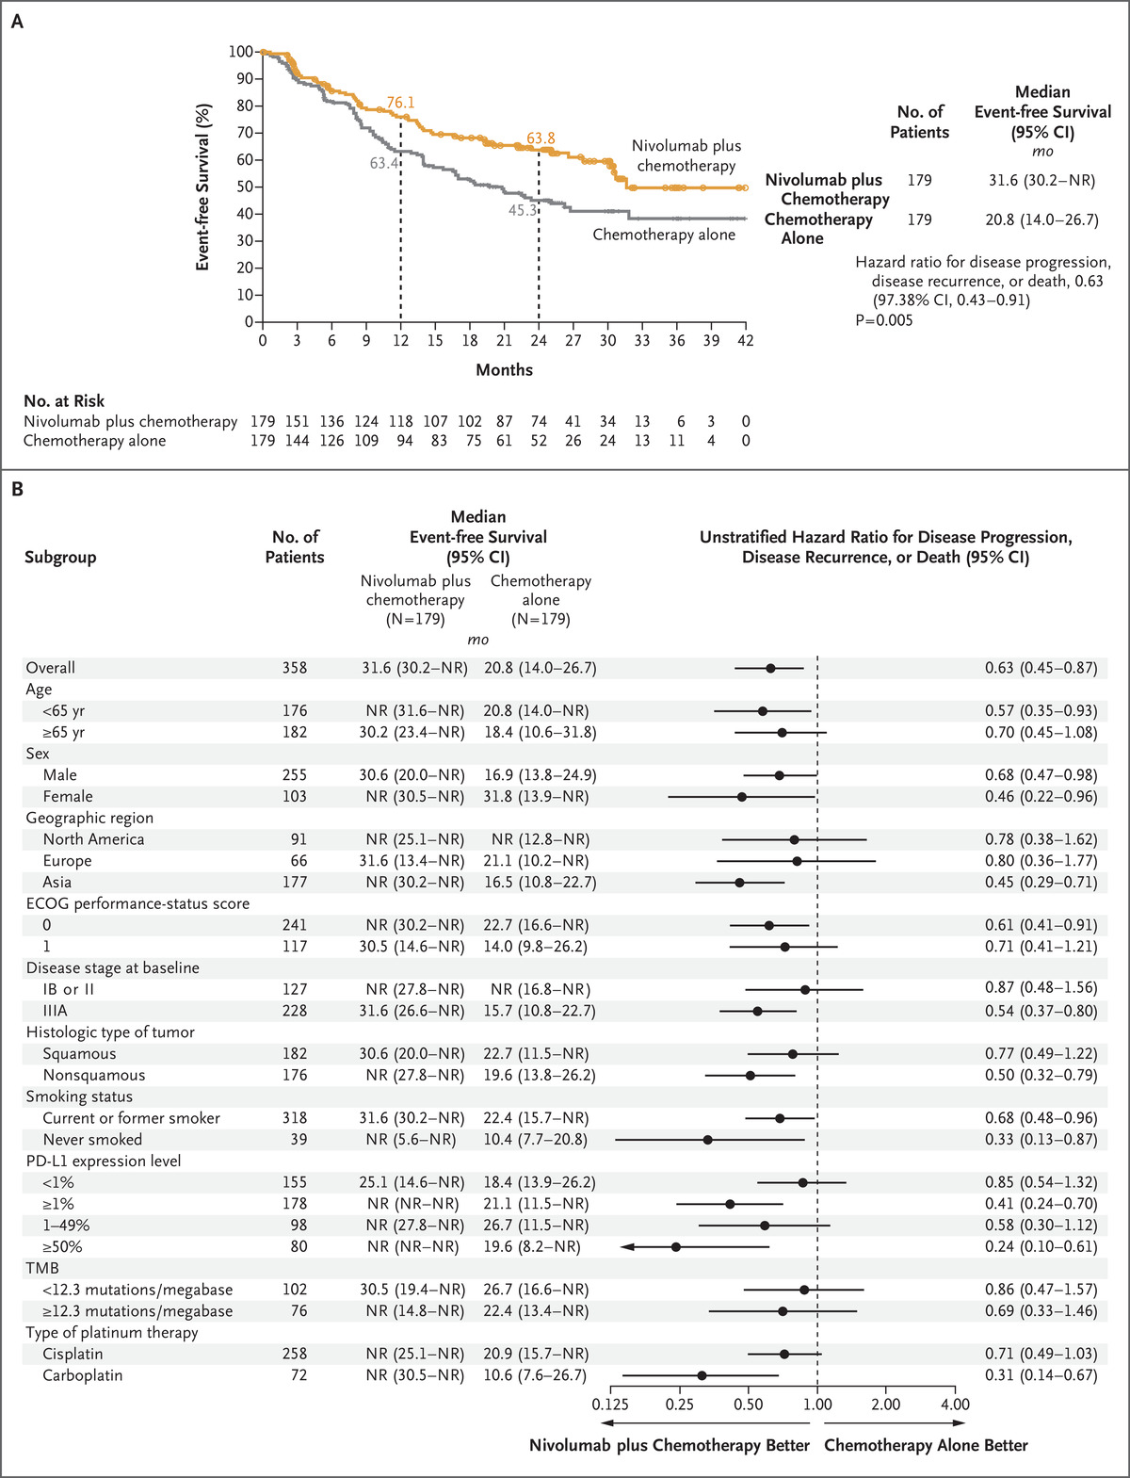
pCR and PD-L1 expression
CheckMate 816—EFS by PD-L1
Provencio et al ASCO 2022; Forde NEJM 2022

Slide 53
Conclusions NADIM II
Supports improvement in surrogate outcomes with immunotherapy and chemotherapy as neoadjuvant treatment for resectable stage III NSCLC
Immunotherapy significantly improved pCR and MPR without surgical delay
Survival data is pending
Multiple trials will provide additional information in the neoadjuvant and adjuvant space soon

Slide 54
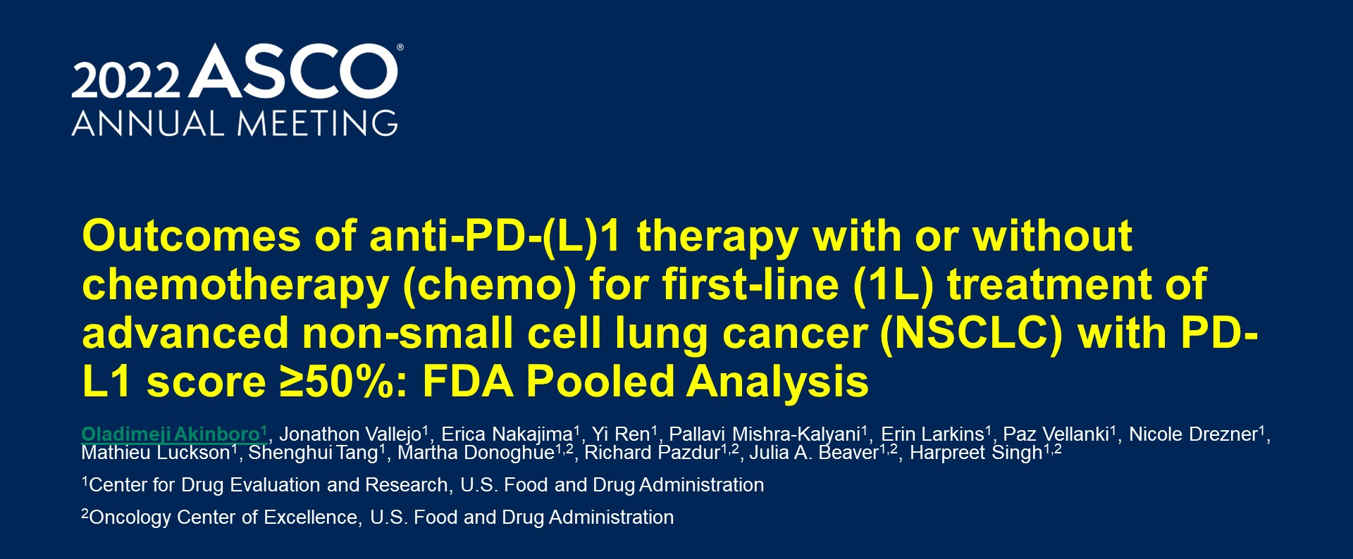
Outcomes of anti-PD-(L)1 therapy with or without chemotherapy (chemo) for first-line (1L) treatment of advanced non-small cell lung cancer (NSCLC) with PD-L1 score ≥50%: FDA Pooled Analysis

Slide 55
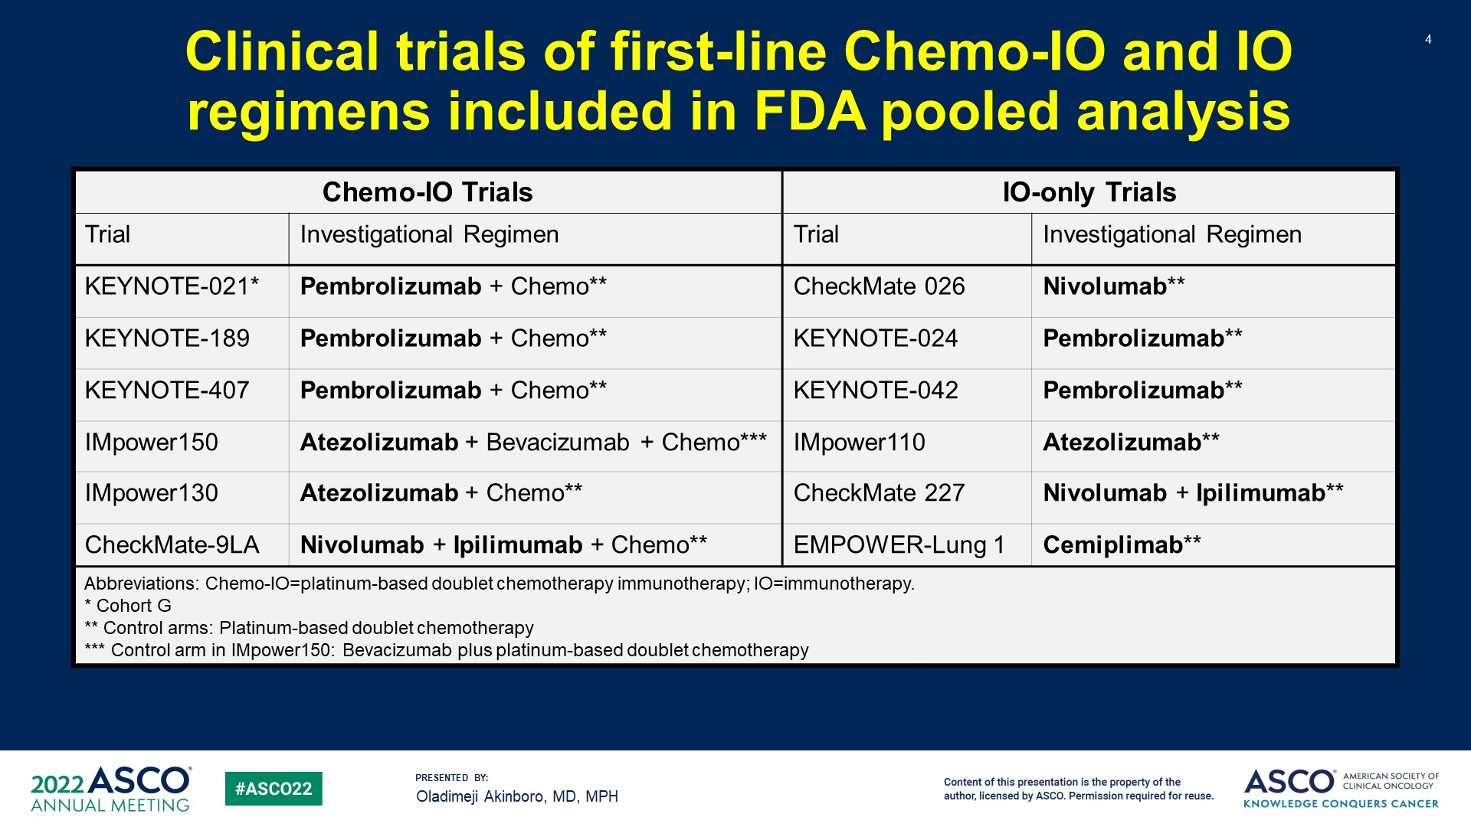
Clinical trials of first-line Chemo-IO and IO regimens included in FDA pooled analysis

Slide 56
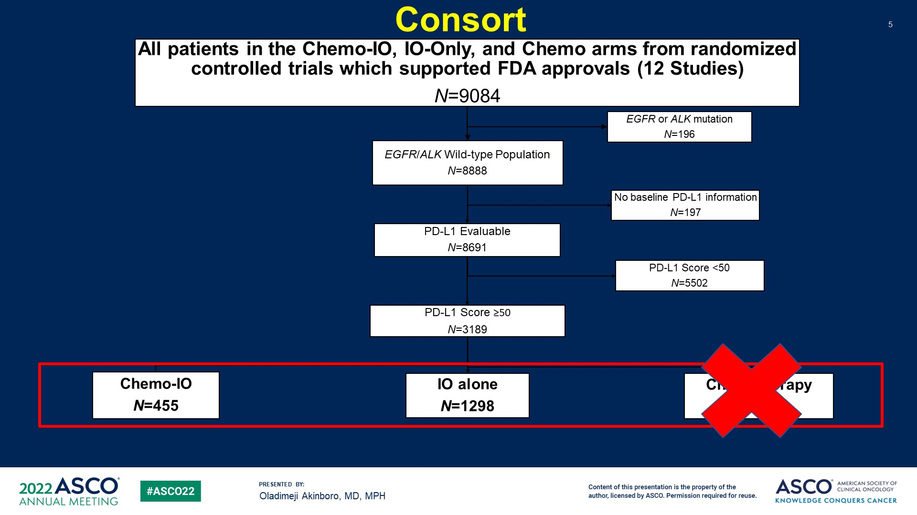
Consort

Slide 57
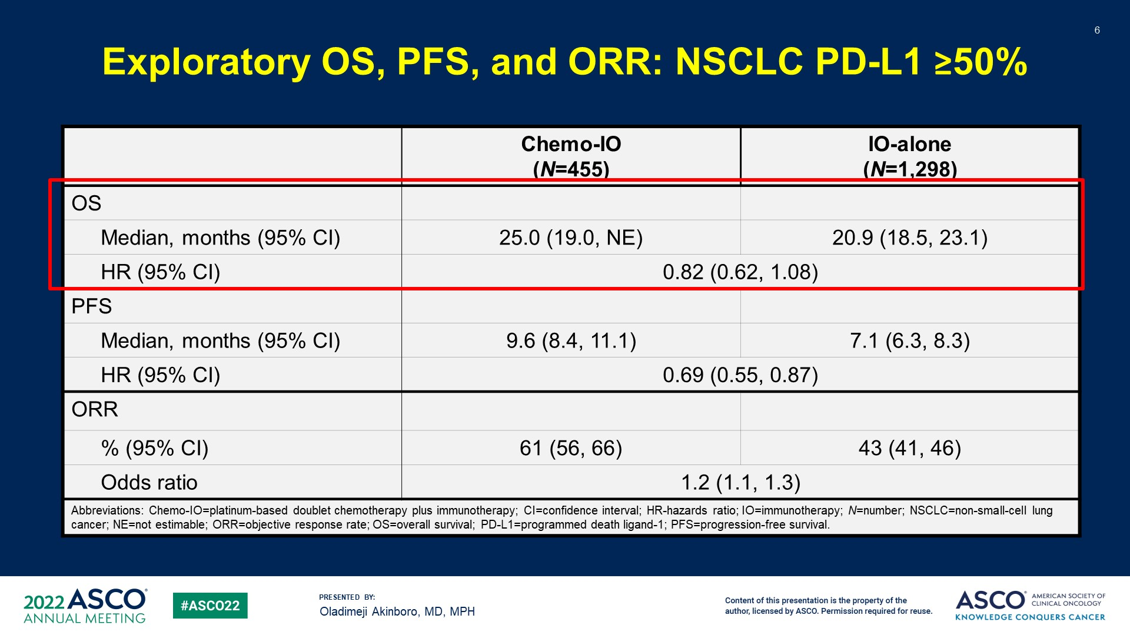
Exploratory OS, PFS, and ORR: NSCLC PD-L1 ≥50%

Slide 58
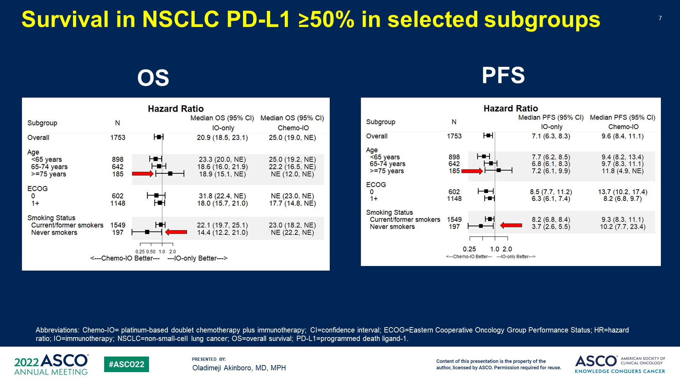
Survival in NSCLC PD-L1 ≥50% in selected subgroups

Slide 59
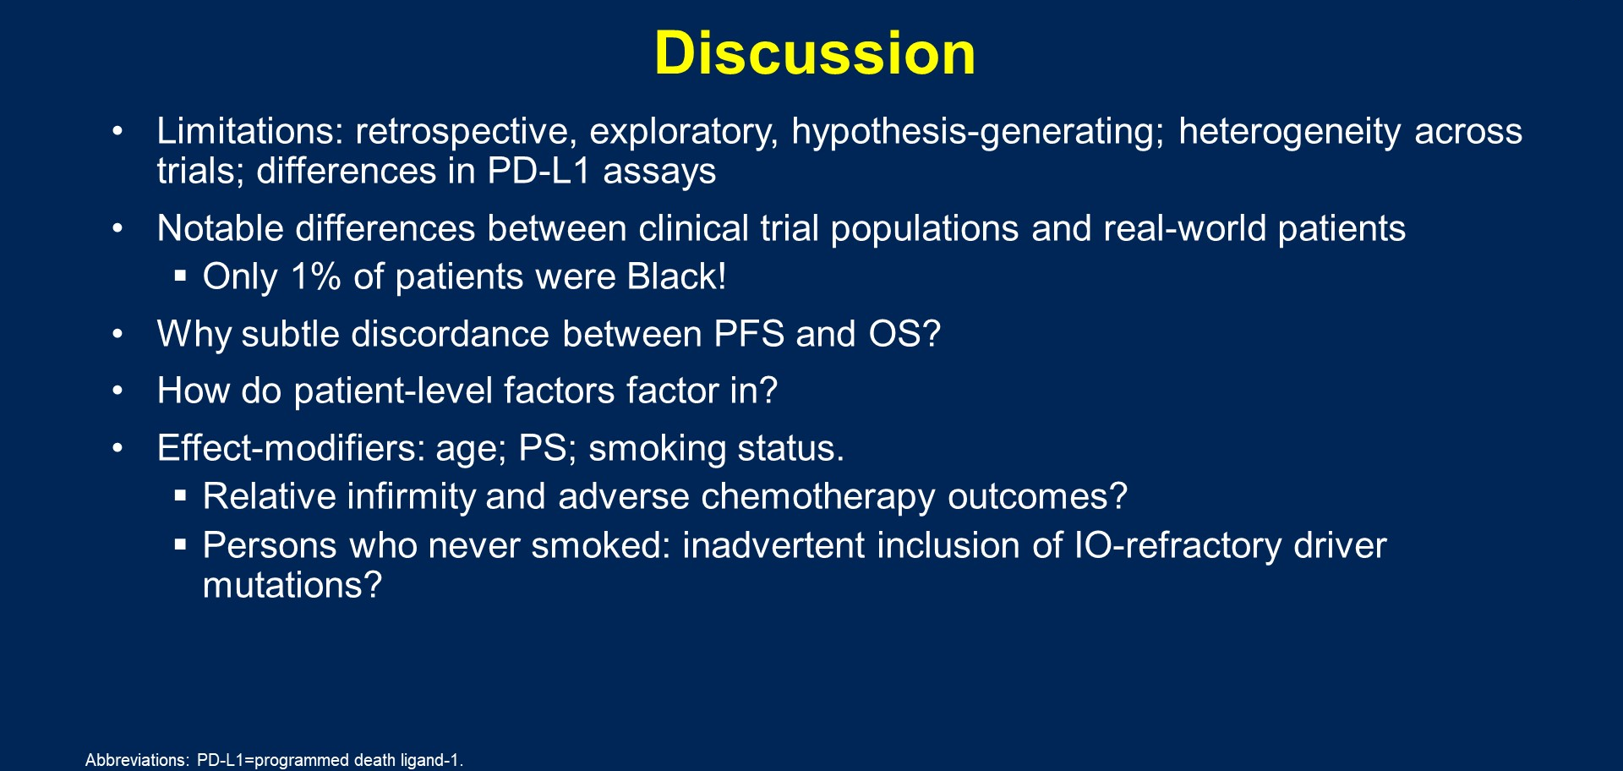
Discussion

Slide 60
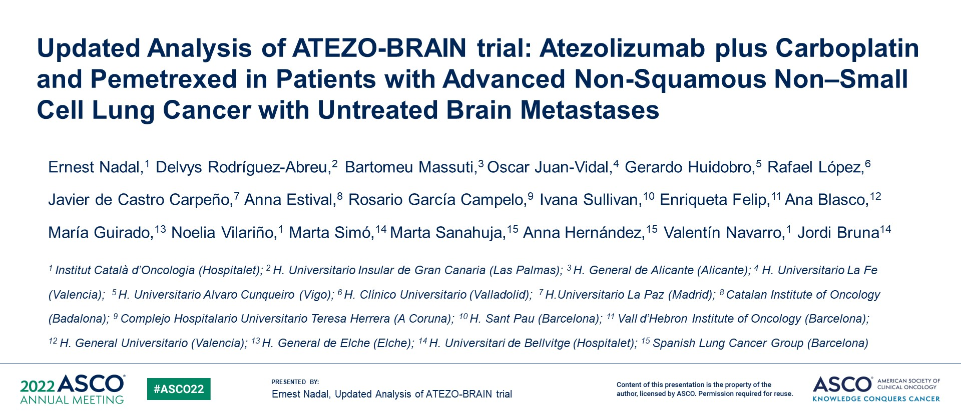
Updated Analysis of ATEZO-BRAIN trial: Atezolizumab plus Carboplatin and Pemetrexed in Patients with Advanced Non-Squamous Non–Small Cell Lung Cancer with Untreated Brain Metastases

Slide 61

Study Design
Nadal et al ASCO 2022

Slide 62

Baseline Characteristics
Nadal et al ASCO 2022

Slide 63

Systemic and Intracranial Best Overall Response Rate
Nadal et al ASCO 2022

Slide 64

Systemic and Intracranial Best Overall Response Rate
Nadal et al ASCO 2022

Slide 65

Updated Survival Analysis
Nadal et al ASCO 2022

Slide 66

Posthoc Analysis of Time until Brain Radiotherapy
Nadal et al ASCO 2022

Slide 67

Conclusions

Slide 68
Overall survival from a phase II randomized study of ramucirumab plus pembrolizumab versus standard of care for advanced non-small cell lung cancer previously treated with immunotherapy—Lung-MAP non-matched sub-study S1800A
68
Karen L. Reckamp, M.D.¹, Mary W. Redman, PhD², Konstantin H. Dragnev, M.D.³, Liza Villaruz, M.D.⁴, Bryan Faller, MD⁵; Tareq Al Baghdadi, MD⁶, Susan Hines, MD⁷, Lu Qian, M.S.², Katherine Minichiello, M.S.², David R. Gandara, M.D.⁸, Karen Kelly, MD⁸, Roy S. Herbst, M.D., Ph.D.⁹
¹Cedars-Sinai Medical Center, Los Angeles, CA; ²SWOG Statistics and Data Management Center & Fred Hutchinson Cancer Research Center, Seattle, WA; ³Dartmouth-Hitchcock Norris Cotton Cancer Center, Lebanon, NH/Alliance for Clinical Trials in Cancer; ⁴University of Pittsburgh Medical Center (UPMC) Hillman Cancer Center; ⁵Missouri Baptist Medical Center, St. Louis, MO/Heartland NCORP; ⁶IHA Hematology Oncology Consultants-Ann Arbor/Michigan CRC NCORP; ⁷Novant Health Cancer Institute - Mount Airy/Southeast Clinical Oncology Research Consortium NCORP); ⁸UC Davis Comprehensive Cancer Center, Sacramento, CA; ⁹Yale University, New Haven, CT
Karen L. Reckamp, MD, MS

Slide 69

S1800A Schema—Randomized Phase II trial
NCT03971474
Stratified by 1) PD-L1 expression, 2) histology, 3) intent to receive ramucirumab in standard of care arm
Primary endpoint: OS
Secondary endpoints: RR, DCR, DoR, PFS, Toxicities
ARM A
Investigator’s Choice
Standard of Care
docetaxel + ramucirumab; docetaxel; gemcitabine; pemetrexed (nonSCC only)
Randomization
ARM B
Pembrolizumab 200 mg Q3W for up to 35 cycles + Ramucirumab 10 mg/kg Q3W
R (1:1)
N= 130
Key eligibility: 1) Previously received PD-1 or PD-L1 inhibitor therapy with PD at least 84 days after initiation of ICI and platinum-based doublet therapy; 2) ECOG 0-1
Karen L. Reckamp, MD, MS

Slide 70
Patient Characteristics
 | Standard of Care (n = 67) | Ramucirumab/ Pembrolizumab (n = 69)
Median age (years) (range) | 65.8 (45.6-84.3) | 66.4 (37.6-85.3)
Sex, n (%)
Male | 42 (63) | 41 (59)
Female | 25 (37) | 28 (41)
Race/ethnicity, n (%)
White | 58 (87) | 60 (87)
Black | 6 (9) | 5 (7)
Asian | 2 (3) | 1 (1)
Native American |  | 1 (1)
Multiracial | 1 (1)
Unknown |  | 2 (3)
Hispanic |  | 2 (3)
Histology, n (%)
Adenocarcinoma | 39 (58) | 36 (52)
Squamous cell carcinoma | 27 (40) | 28 (41)
Mixed | 1 (1) | 1 (1)
NSCLC NOS | 0 | 4 (6)
 | Standard of Care (n = 67) | Ramucirumab/ Pembrolizumab (n = 69)
Zubrod Performance Status, n (%)
0 | 9 (13) | 23 (33)
1 | 58 (87) | 46 (67)
Smoking history, n (%)
Current | 18 (27) | 19 (28)
Former | 43 (64) | 44 (64)
Never | 6 (9) | 6 (9)
PD-L1 status, n (%)
<1% | 26 (41) | 29 (47)
≥1% | 38 (59) | 33 (53)
1-49% | 22 (34) | 21 (34)
≥50% | 16 (25) | 12 (19)
Unknown | 3 (4) | 7 (10)
Tumor Mutational Burden by F1CDXª
Median, (Range, ICR range) | 7.6 (0–25.2, 3.8–12.6) | 10.1 (0–40.4, 5.0–15.1)
≥10 | 25 (40) | 33 (51)
Data are No. (%) unless otherwise stated. Abbreviations: ICR, interquartile; NOS, not otherwise specified. ªPercentages in categories calculated among those with known status only.
Karen L. Reckamp, MD, MS

Slide 71
Overall survival
Median OS for RP 14.5 months v. SOC 11.6 months
HR= 0.69; SLR p-value 0.05
Standard of care therapy received:
Docetaxel + Ramucirumab (n = 45)
Docetaxel (n = 3)
Gemcitabine (n = 12)
Pemetrexed (n = 1)
No treatment (n = 6)
Karen L. Reckamp, MD, MS
Notes:
log-rank p-value is < 0.1 , and study met overall threshold < 10% type I error

Slide 72
Overall survival—subgroup analysis
All subgroup HRs < 1
HRs by PD-L1 does not appear to vary
Pronounced benefit in SCC/mixed histology
Benefit seen with PS 0 and 1
Co-mutations did not affect OS improvement
Karen L. Reckamp, MD, MS

Slide 73
Progression free survival with subgroup analysis
Karen L. Reckamp, MD, MS

Slide 74

Cabozantinib Plus Atezolizumab or Cabozantinib Alone in Patients With Advanced Non-Small Cell Lung Cancer Previously Treated With an Immune Checkpoint Inhibitor: COSMIC-021 Study Cohorts 7 and 20

Slide 75


COSMIC-021: Cabozantinib +Atezolizumab
Neal JW, et al. ASCO 2022

Slide 76

COSMIC-021 Study Design
Neal ASCO 2022

Slide 77

COSMIC-021 Patient Characteristics
Neal ASCO 2022

Slide 78

Slide 21
COSMIC-021 Efficacy
Neal ASCO 2022

Slide 79
Selected Trials: Cabozantinib + ICI in NSCLC
Study | Setting | Regimen | No. Patients
Phase III—CONTACT-01 NCT04471428 | Progression after platinum doublet + PD-(L)1 therapy | Cabozantinib + Atezo vs. Docetaxel | Active, Not recruiting
Phase II EA5191; NCT04310007 | Progression after platinum doublet + PD-(L)1 therapy (Separate MET, RET, ROS1 cohort) | Cabozantinib vs Cabozantinib + Nivo vs. Standard chemotherapy | Recruiting

Slide 80
Conclusions
Ramucirumab and Pembrolizumab in pts with advanced NSCLC previously treated with immunotherapy and prior platinum-based chemotherapy improved OS compared to SOC (most received docetaxel and ramucirumab)
Further evaluation of this approach is warranted
Multiple trials evaluating immunotherapy and VEGFR TKIs are ongoing with results anticipated
Combination VEGFR and ICI showing early signs of benefit in patients with NSCLC who have received prior immunotherapy
Karen L. Reckamp, MD, MS

Slide 81

SKYSCRAPER-02: Primary results of a phase III, randomized, double-blind, placebo-controlled study of atezolizumab + carboplatin + etoposide with or without tiragolumab in patients with untreated extensive-stage small cell lung cancer

Slide 82

SKYSCRAPER-02: Randomized, double-blind, placebo-controlled study of tiragolumab + atezolizumab + chemotherapy in patients with untreated ES-SCLC
Rudin ASCO 2022

Slide 83

Slide 11
Rudin ASCO 2022

Slide 84

SKYSCRAPER-02: Randomized, double-blind, placebo-controlled study of tiragolumab + atezolizumab + chemotherapy in patients with untreated ES-SCLC
Rudin ASCO 2022

Slide 85

Chemo-immunotherapy for First-line ES-SCLC

Slide 86
SCLC immunotherapy conclusions
Tiragolumab did not enhance treatment with chemo-immunotherapy for ES-SCLC
Future studies must focus on selection as we understand SCLC biology and subtypes
SCLC-I most likely to benefit from immunotherapy regimens
SCLC-A, N, P may require alternate approaches
We need to improve biomarker selection in SCLC (limited by tissue acquisition)

Slide 87

The Real Barriers to Clinical Trials Participation

Slide 88
THANK YOU!

