Slide 1
ESMO 2022 NSCLC Highlights Webinar
Jordi Remon Masip, MD, PhD
Gustave Roussy, Villejuif, France
Lizza Hendriks, MD, PhD
Maastricht UMC, the Netherlands
Nicolas Girard, MD
Institut Curie, Paris, France

Slide 2
APPLE phase II Trial
Remon – ESMO 2022

Slide 3
APPLE phase II Trial
Remon – ESMO 2022

Slide 4
APPLE phase II Trial
Remon – ESMO 2022

Slide 5
CODEBREAK 200 phase III trial
Primary endpoint: PFS by BIRC
Protocol amended (regulatory guidance):
Crossover docetaxel – sotorasib
Pt number ↓650 -> 330
PFS
Johnson – ESMO 2022

Slide 6
CODEBREAK 200 phase III trial
OS
TOX
Sotorasib most common TRAE:
diarrhea, nausea, loss appetite, liver test abn
In docetaxel arm 34% cross-over to KRASi
Johnson – ESMO 2022

Slide 7
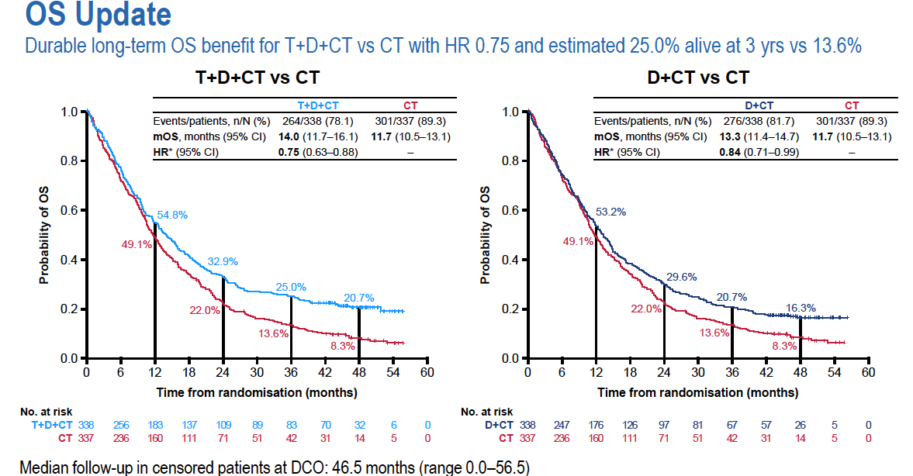
POSEIDON phase III trial
Johnson – ESMO 2022
Notes:
3-yOS In CM9LA: 27%
The addition of tremelimumab was more positive in non-squamus andin PD-L1 negative tumors

Slide 8
POSEIDON phase III trial
Johnson – ESMO 2022

Slide 9
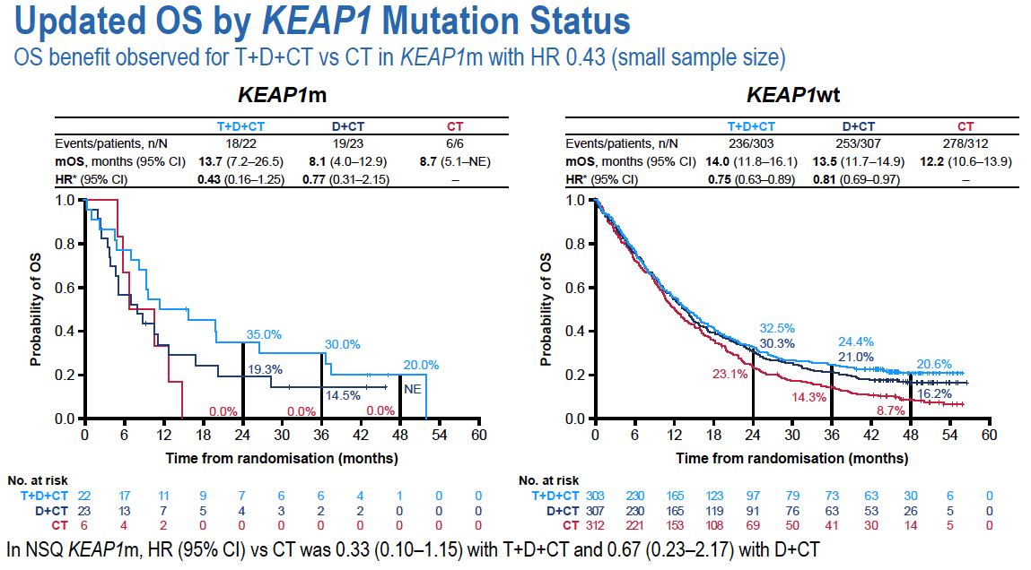
POSEIDON phase III trial
Johnson – ESMO 2022

Slide 10
POSEIDON phase III trial
Johnson – ESMO 2022

Slide 11
EMPOWER-Lung 01
Özgüroğlu- ESMO 2022
Notes:
3Y PFS: 8.1 vs 5,3 HR: 0.51; RR: 46 vs 21%

Slide 12
EMPOWER-Lung 01
 | Period 1 | Period 2
RR | 29.7% (CR: 0%; PD: 20%) | 31.3% (CR: 5%; PD: 14%)
PFS | 6.2 1-year PFS: 24.1% | 6.6 1-y PFS: 31.2%
OS |  | 15.1 1-year OS: 56.8% Period 1+2: 27.4 mo.
G≥3 |  | 35.9%
Özgüroğlu- ESMO 2022
Notes:
No Randomization / choice of investigator
Limited Number of post PD patients - Selection Bias unavoidable

Slide 13
Özgüroğlu- ESMO 2022

Slide 14
KEYNOTE 189 phase III 5 year update
Primary endpoints:
OS and PFS
57% effective cross-over rate
Garassino – ESMO 2022

Slide 15
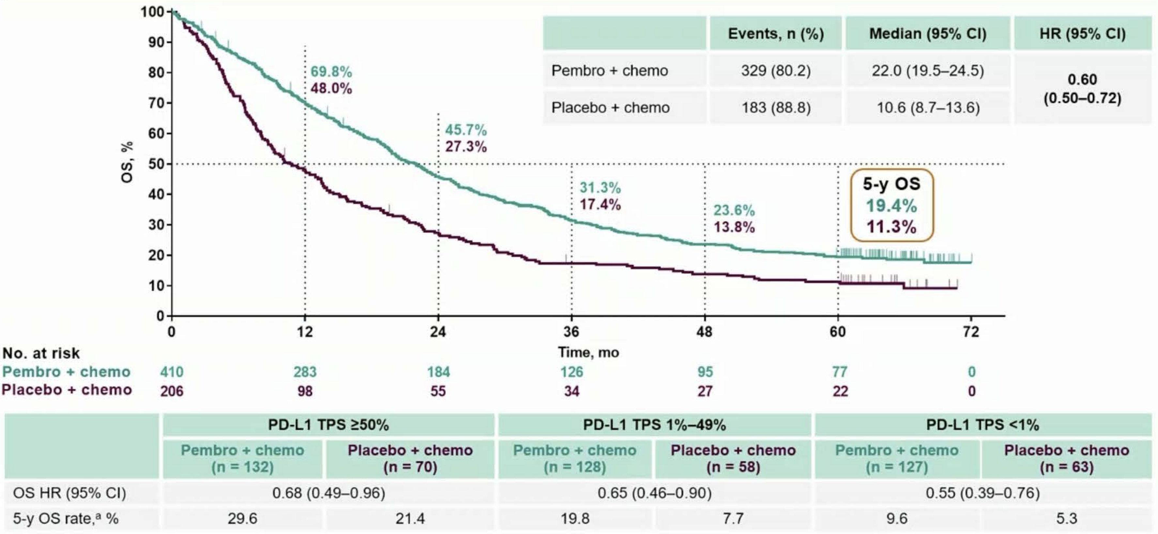
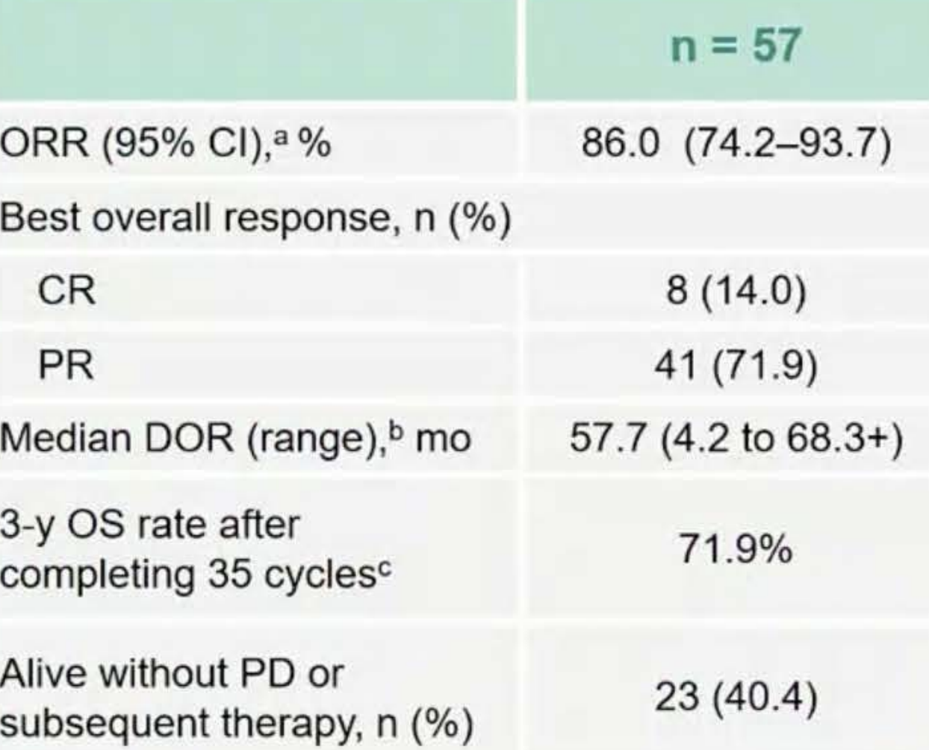
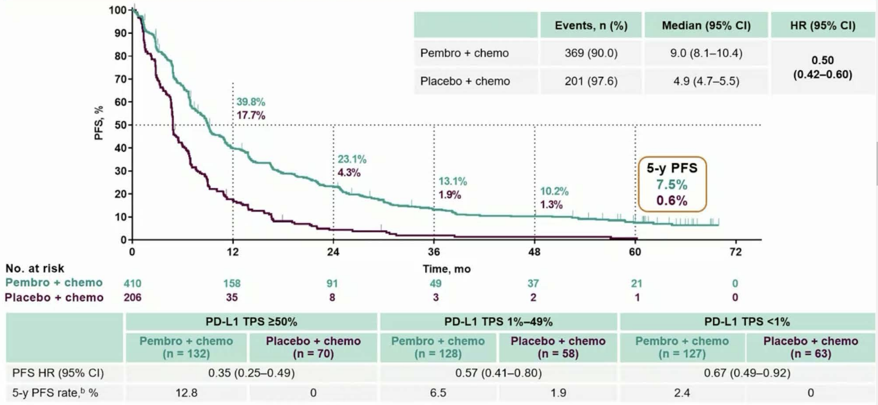
KEYNOTE 189 phase III 5 year OS and PFS
OS
5y OS 19 vs 11%
Outcomes in patients completing 35 cycles
PFS
5y PFS 8 vs 1%
Garassino – ESMO 2022

Slide 16
KEYNOTE 407 phase III 5 year update
Primary endpoints:
OS and PFS
51% effective cross-over rate
Novello – ESMO 2022

Slide 17
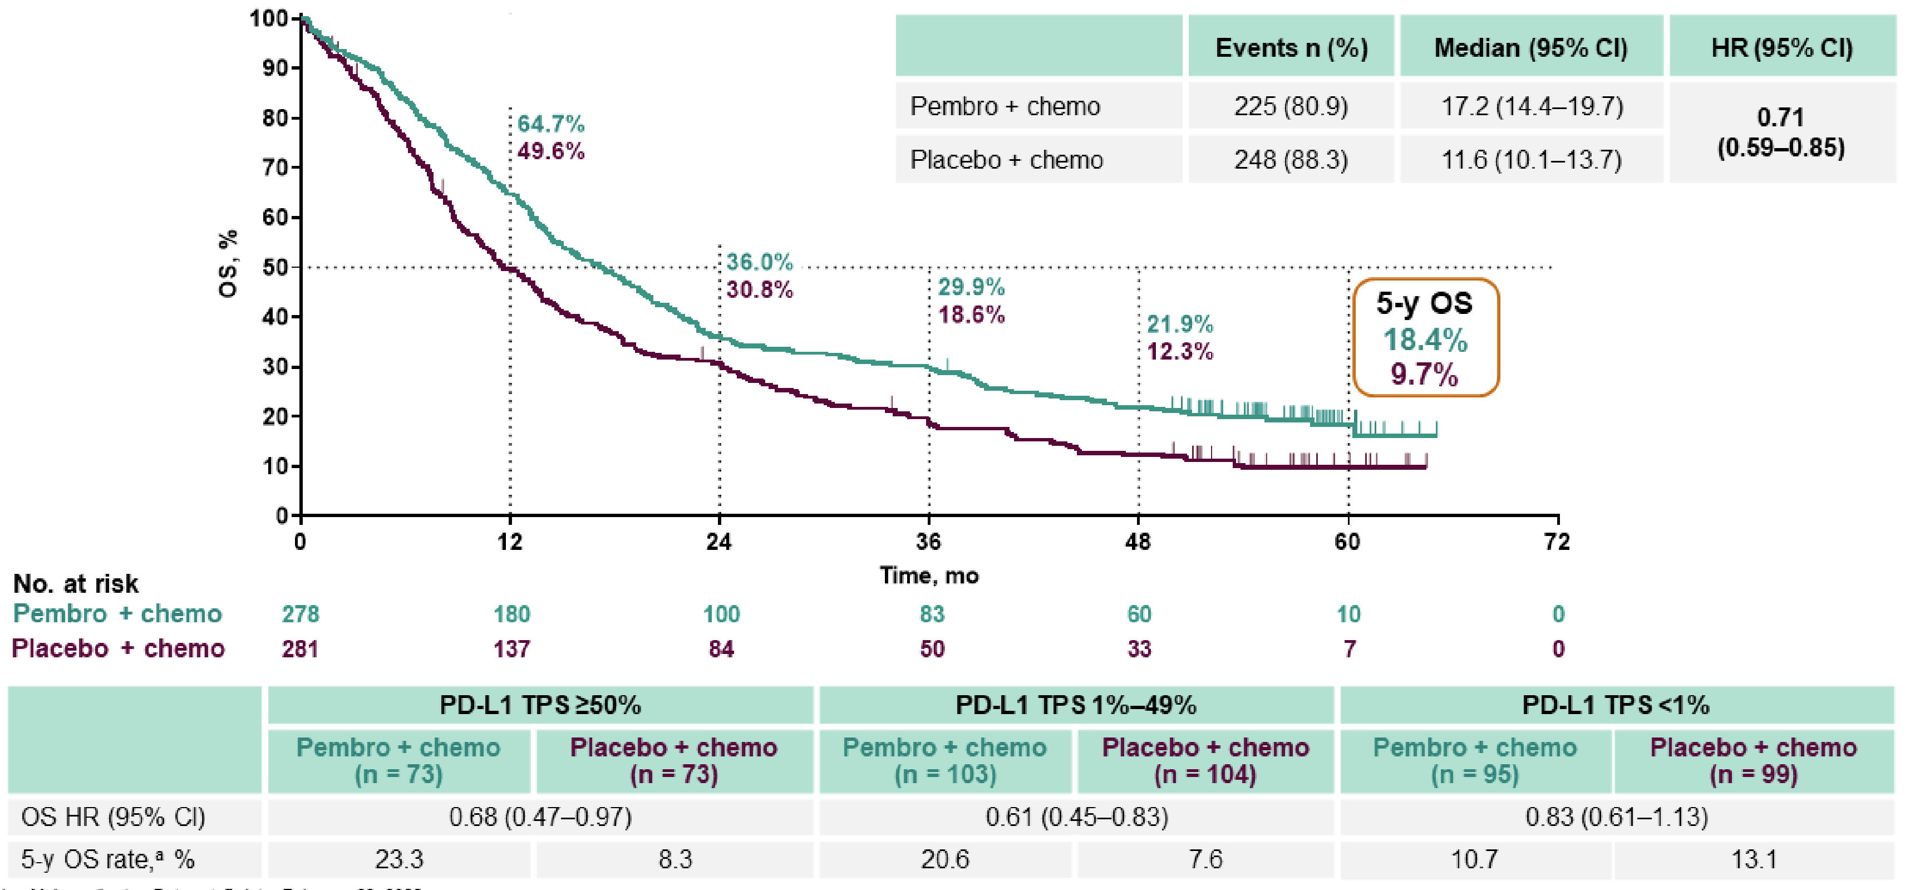
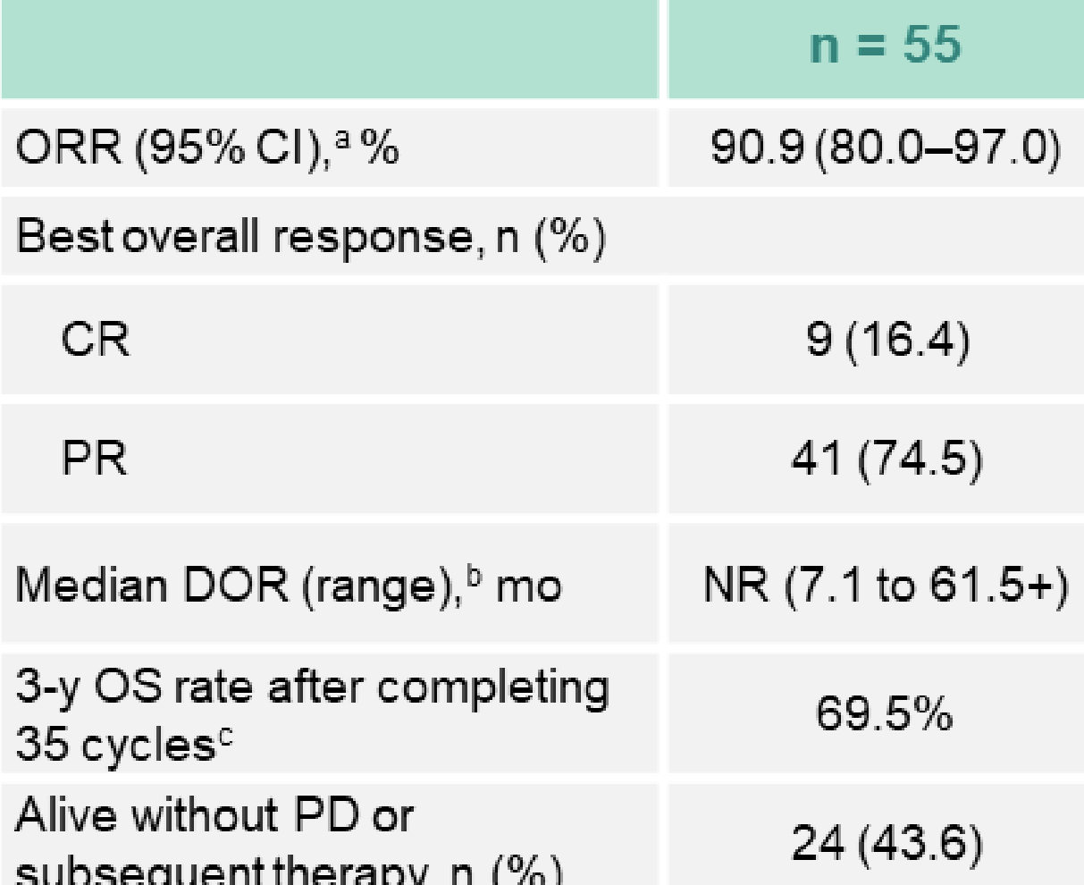
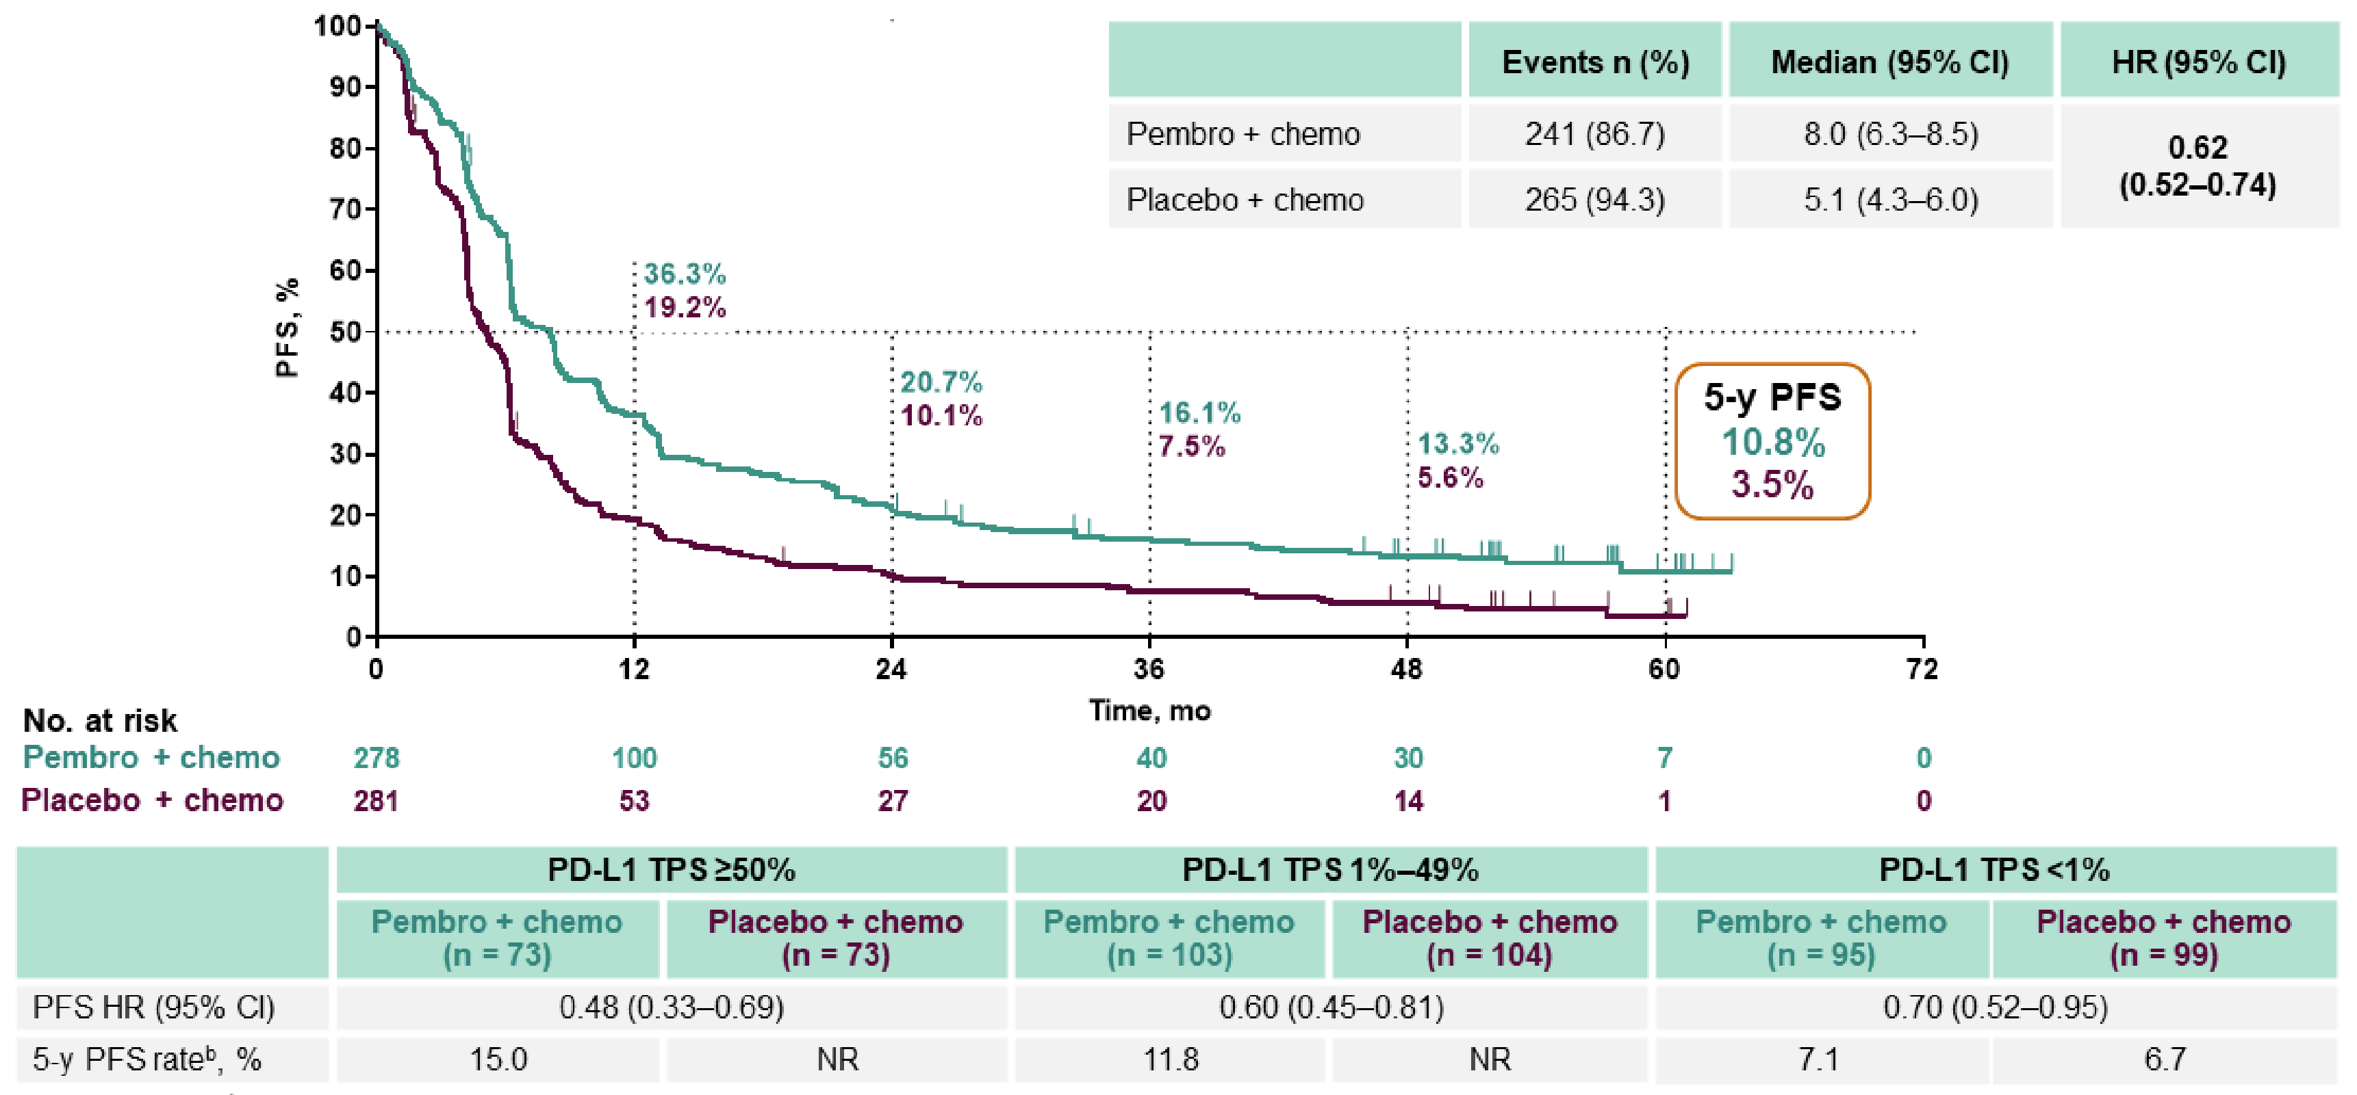
KEYNOTE 407 phase III 5 year OS
OS
5y OS 18 vs 10%
Outcomes in patients completing 35 cycles
PFS
5y PFS 11 vs 4%
Novello – ESMO 2022

Slide 18
DICIPLE PHASE III
816 patients/651 events needed for 80% power – 1-sided error 0.025, non-inferiority margin HR 1.25
Accrual stopped early: nivo-ipi no EMA approval
Zalcman – ESMO 2022

Slide 19
DICIPLE PHASE III RCT
Patient disposition
PFS
Continuation vs stop & go
mPFS 20.8 vs 35.2 months
12m PFS 56 vs 81% p = 0.12
Zalcman – ESMO 2022

Slide 20
ADAURA phase III Trial
Tsuboi – ESMO 2022
Notes:
Here we will present an updated analysis of the final DFS data at the protocol-specified maturity of 50%, a pre-specified exploratory analysis of recurrence patterns and updated safety data, after 2 years of further follow up, in which all patients have had the opportunity to receive the full 3 years of adjuvant treatment

Slide 21
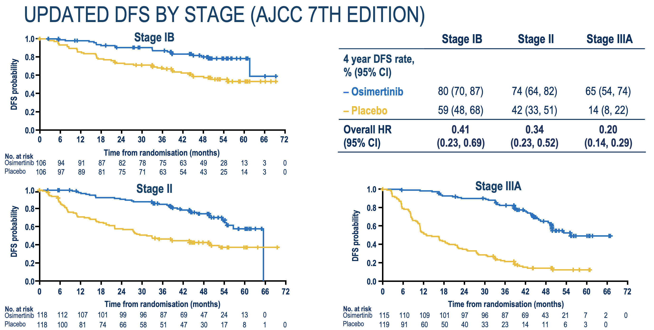
ADAURA phase III Trial
Tsuboi – ESMO 2022

Slide 22
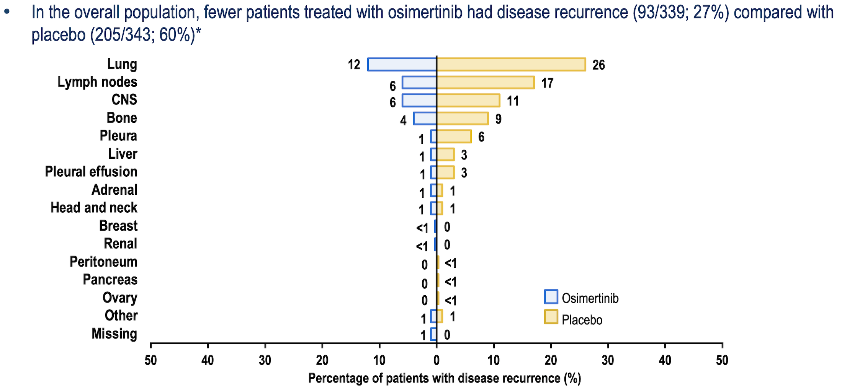
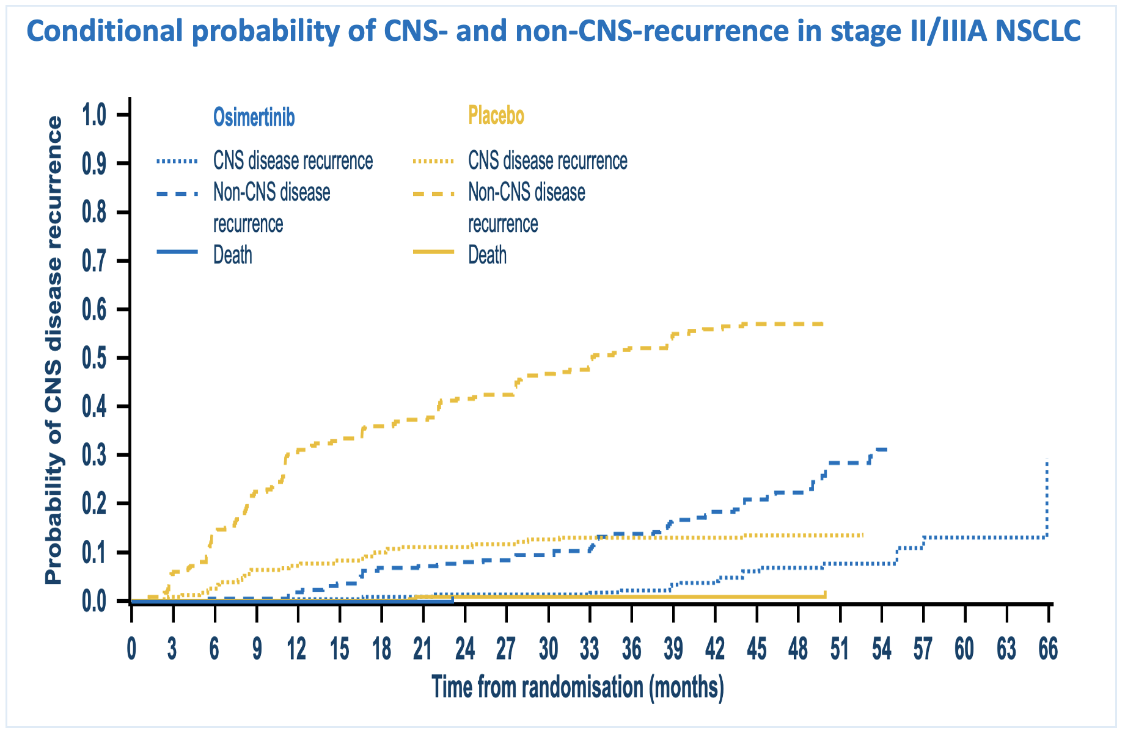
ADAURA phase III Trial
Distant only : 13% (45/339)
Locoregional: 12% (42/339)
Distant only : 31% (107/343)
Locoregional: 23% (78/343)
Tsuboi – ESMO 2022

Slide 23
KEYNOTE 091/PEARLS PHASE III
Primary endpoints
DFS overall
DFS in PD-L1 ≥50%
DFS overall
HR 0.76 (95% CI 0.63-0.91)
Peters – ESMO 2022

Slide 24
KEYNOTE 091/PEARLS PHASE III
TPS ≥50% HR 0.82 (0.57-1.18)
TPS 1-49% HR 0.67 (0.48-0.92)
TPS <1%% HR 0.78 (0.58-1.03)
Pembro DFS according to PD-L1
placebo DFS according to PD-L1
Peters – ESMO 2022

